Slide 1
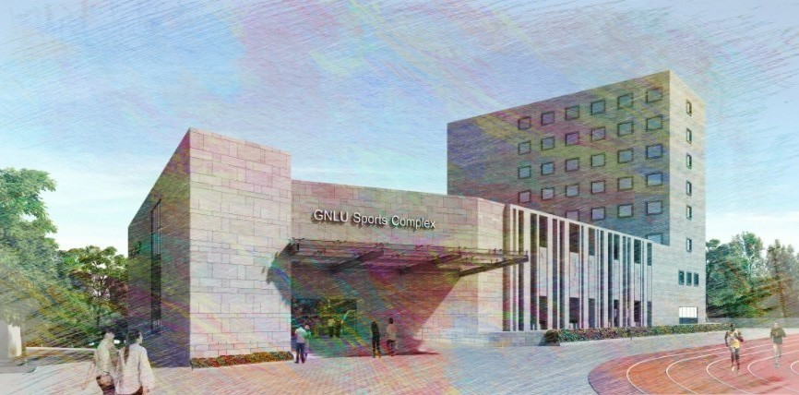
Architectural and structural services for
Development and construction of Sports Facilities (Complex) in the Campus of
Gujarat National Law University, Gandhinagar
A presentation to GNLU

Slide 2
Project Introduction
Project Requirements
Development Controls / Bylaws References
Site introduction
Conceptual Design
Sustainable Approach
Approach and methodology
Budgetary Estimate

Slide 3
Project Introduction
The aim of GNLU to develop and built the world-class sports complex including outdoor sports facilities in different phases comprising modern facilities, sustainable energy efficiency measures in accordance with the standards/ guideline.

Slide 4
Project Introduction
Project Requirements
Development Controls / Bylaws References
Site introduction
Conceptual Design
Sustainable Approach
Approach and methodology
Budgetary Estimate

Slide 5
Project requirement
Multipurpose sports hall including games like, badminton, basket ball, volleyball, handball, netball and table tennis
Other indoor sports facilities such as boxing ring, judo, weight lifting, gym, yoga
400m Synthetic Athletics Track
Outdoor play fields such as Football Field, Hockey, lawn tennis, volleyball, kabaddi, kho-kho
50 mtr. Swimming Pool
Audio-Video Hall, Lecture Hall
Viewing Galley
Health Center/Dispensary, Sports Physiotherapy Center, Students Recreation
Canteen/ cafeteria
Boys and Girls Dormitory, Single and double sharing accommodation
VIP Parking

Slide 6
Project Introduction
Project Requirements
Development Controls / Bylaws References
Site introduction
Conceptual Design
Sustainable Approach
Approach and methodology
Budgetary Estimate

Slide 7
Following bylaws were referred while development of conceptual design.
Comprehensive GDCR for the Gujarat State
Handbook of sports authority of India
In addition to above mentioned bylaws, following were also referred as and when required;
National Building Code of India 2005
IGBC-Green Building Rating System
Bureau Of Energy Efficiency (Bee)
National Green Building Standard

Slide 8
Sr.No. | Particular | Criteria | Required / Permissible |  | Clause | Pg No.
1 | Zone | Institutional Zone IV | ̅ |  | Part II, Table 6.2 | 6
2 | Permissible Uses | SP&L | Sports Complex, Swimming Pool, Playfield, Camping Ground, Facility forwater sports, Theme/ Amusement Park, Aquarium, Zoo ,Botanical Garden, Exhibition and Mela, motion picture hall |  | Part II, Table 6.3 | 9
3 | FSI | Institutional Zone IV | Permissible (Base) | 1.20 | Part II, Table 6.7 | 13
 |  |  | Chargable | 0.30
 |  |  | Maximum permissible | 1.50
4 | Building Height with respect to road width | D1 - Road width 12 mts and less than 18m | 30 mts |  | Part II, Table 6.23 | 22
 |  | D1 - Road width 18 mts and less than 36, | 45 mts
5 | Rear & Side Margin | B.H. > 16.5mt. & B.H. ≤25mt. | 4.00 |  | Part II, Table 6.26 | 24
 |  | B.H. > 25.0mt. & B.H. ≤45mt. | 6.00
6 | Margin from Common Plot |  | 3.00 mt. in case of building height up to 25.0 mt. and 6.00 mt. in case of building height more than 25.0 mt.
7 | Internal road and approach to building and common plot | Length of road/ approach in mt | Width of road/ approach in mt |  | Part II, Table 6.46 | 38
 |  | Upto 45 | 6.00
 |  | Above 45 and upto 75 | 7.50
 |  | Above 75 and upto 150 | 9.00
 |  | Above 150 and upto 450 | 12.00
8 | Minimum common plot | Other than Industrial, Religious, Educational-1&2, Institutional, Assembly, Public Institutional | 10% of the area of Building-unit |  | Part II, Table 6.49 | 40
9 | Parking | Sports & Leisure (SP&L) | Minimum Parking Required | 25% of Building-unit area | Part II, Table 6.44 | 35
 |  |  | Visitors parking | 10% of the required parking
 |  |  |  | 50% of the required visitors parking at the ground level
 |  |  | Car Parking | 50% of all required parking
 |  |  | Parking area includes parking space, driveway and aisles but excludes approach road, vehicular lift and vehicular ramps
10 | Staircase | Non Residential Use except assembly Use | Building ht more than 25m | Min Flight width - 2.0 M Min Tread - 300 MM Max Riser - 160 MM | Part III, 13.2 | 5
 |  |  | Travel Distance (mt) | 25.0 m
11 | Lifts and Elevators | Non residential - Ht of building above10.0m | Min 1, or | 1 Lift per 1000sq.mt built-up area | Part III, 13.12.2 | 15
 |  | Non residential - Height of building above 25.0m | Min 2, or

Slide 9
Project Introduction
Project Requirements
Development Controls / Bylaws References
Site introduction
Conceptual Design
Sustainable Approach
Approach and methodology
Budgetary Estimate

Slide 10
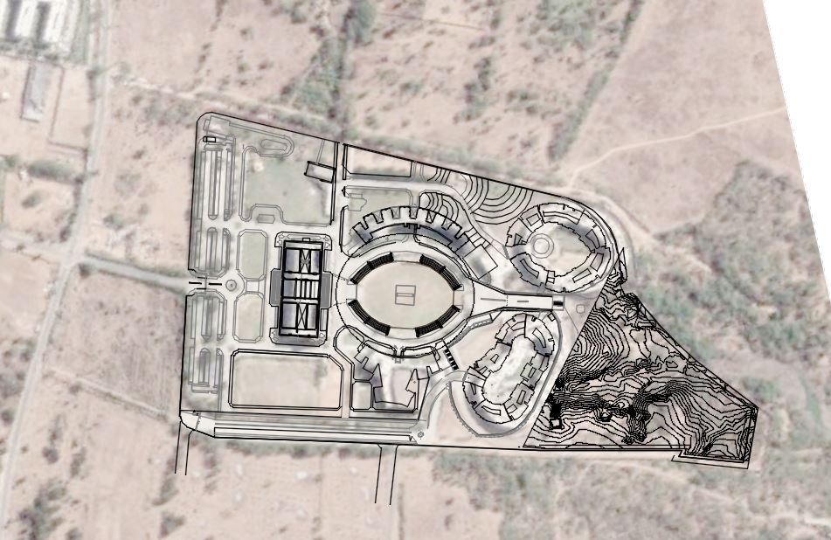

Site Location in existing campus of GNLU
Parking
Existing
GNLP Campus
ECR
Girls
hostel
Admin
WCR
Parking
Boys Hostel &
Guest House
Proposed site location for sports complex at GNLU campus
Approx site area = 29880 Sq.m.

Slide 11
Project Introduction
Project Requirements
Development Controls / Bylaws References
Site introduction
Conceptual Design
Sustainable Approach
Approach and methodology
Budgetary Estimate

Slide 12
Zoning

Slide 13
Zoning
Indoor sports Complex
and Residential tower
Athletic track and
Outdoor sports zone
Swimming Pool

Slide 14
Land formation

Slide 15
+98.50
+95.0
Cutting line
Retaining wall
+90.0

Slide 16
Master plan

Slide 17

Master plan
Existing
Girls hostel
Secondary Entry/Exit
+92.0m
Indoor Sports Complex
+91.6m
Existing
Boys hostel
Slope 1:7
+96.7m
230m
+95.5m
10m wide road
7.5m wide road
400m athletic running track
Space for
field event
6m wide road
Lawn
tennis
Kho-kho
Volleyball
Kabaddi
Football pitch
60m
Main Entry/Exit
`
Swimming pool
50mx25m
+96.0m
+95.0m
+95.0m
4.5m wide road
250m

Slide 18
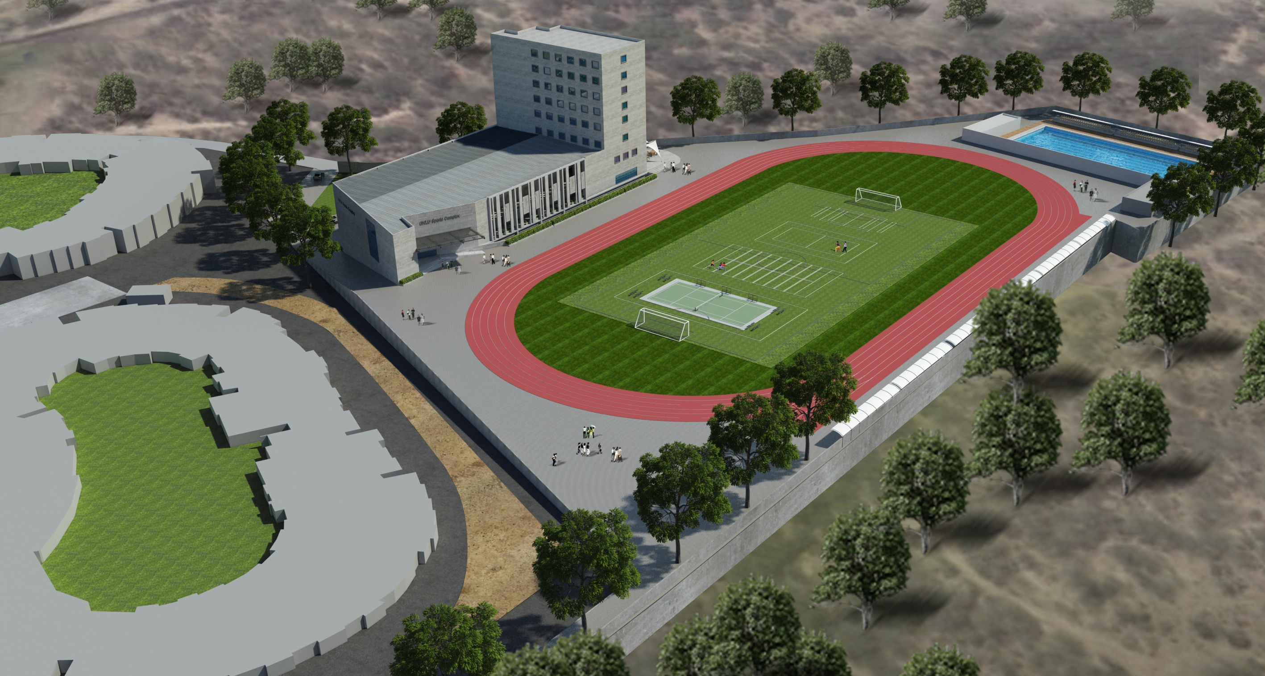
Sports complex

Slide 19
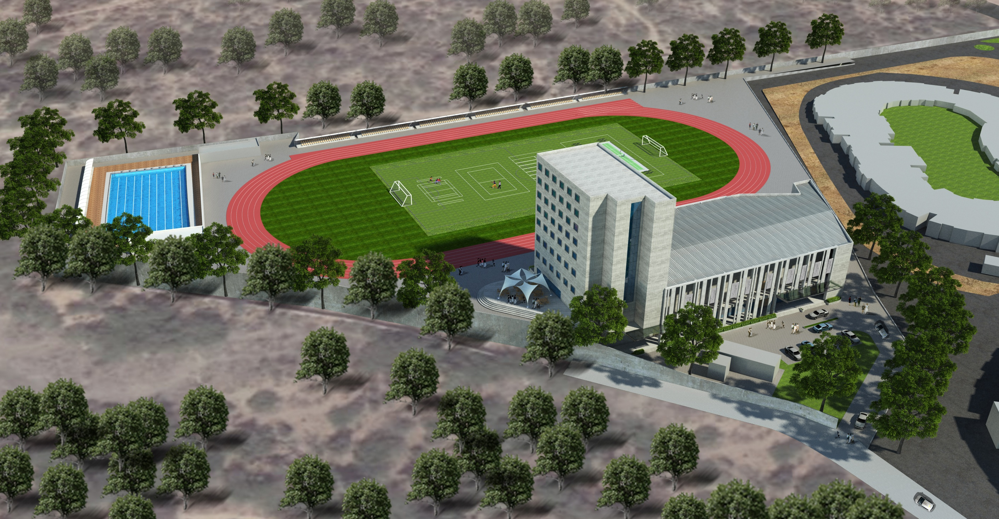
Sports complex

Slide 20
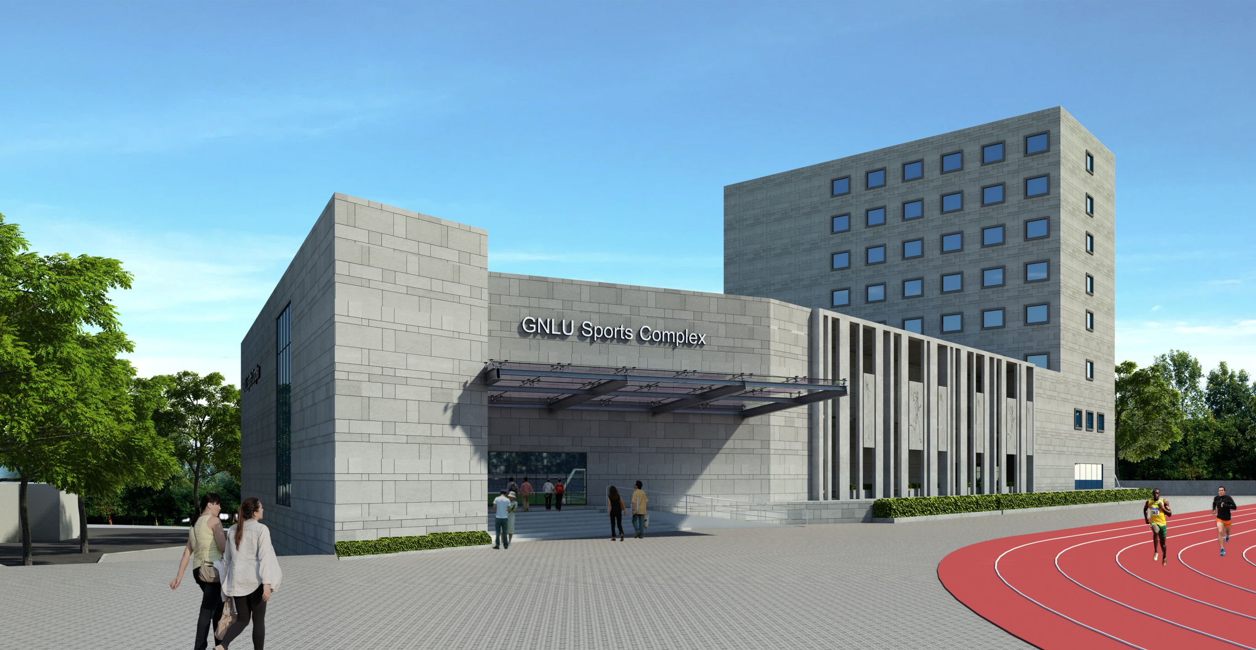
Sports complex

Slide 21
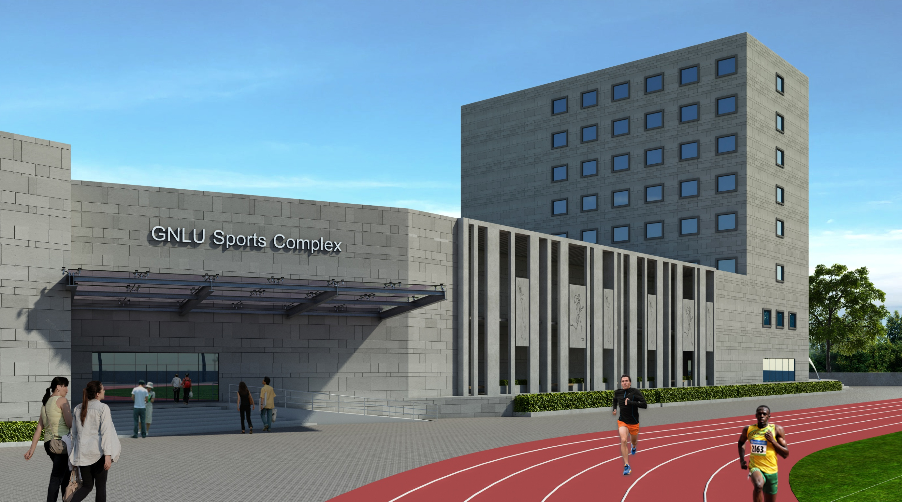
Sports complex

Slide 22
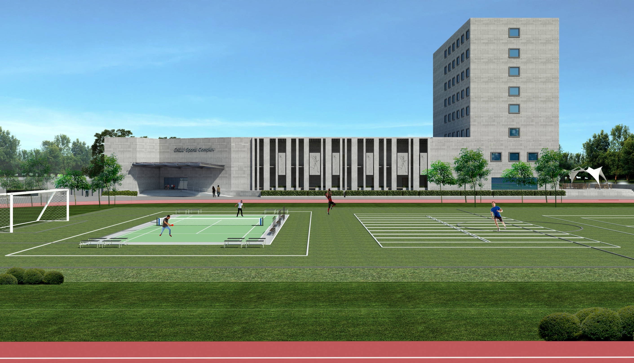
Sports complex

Slide 23
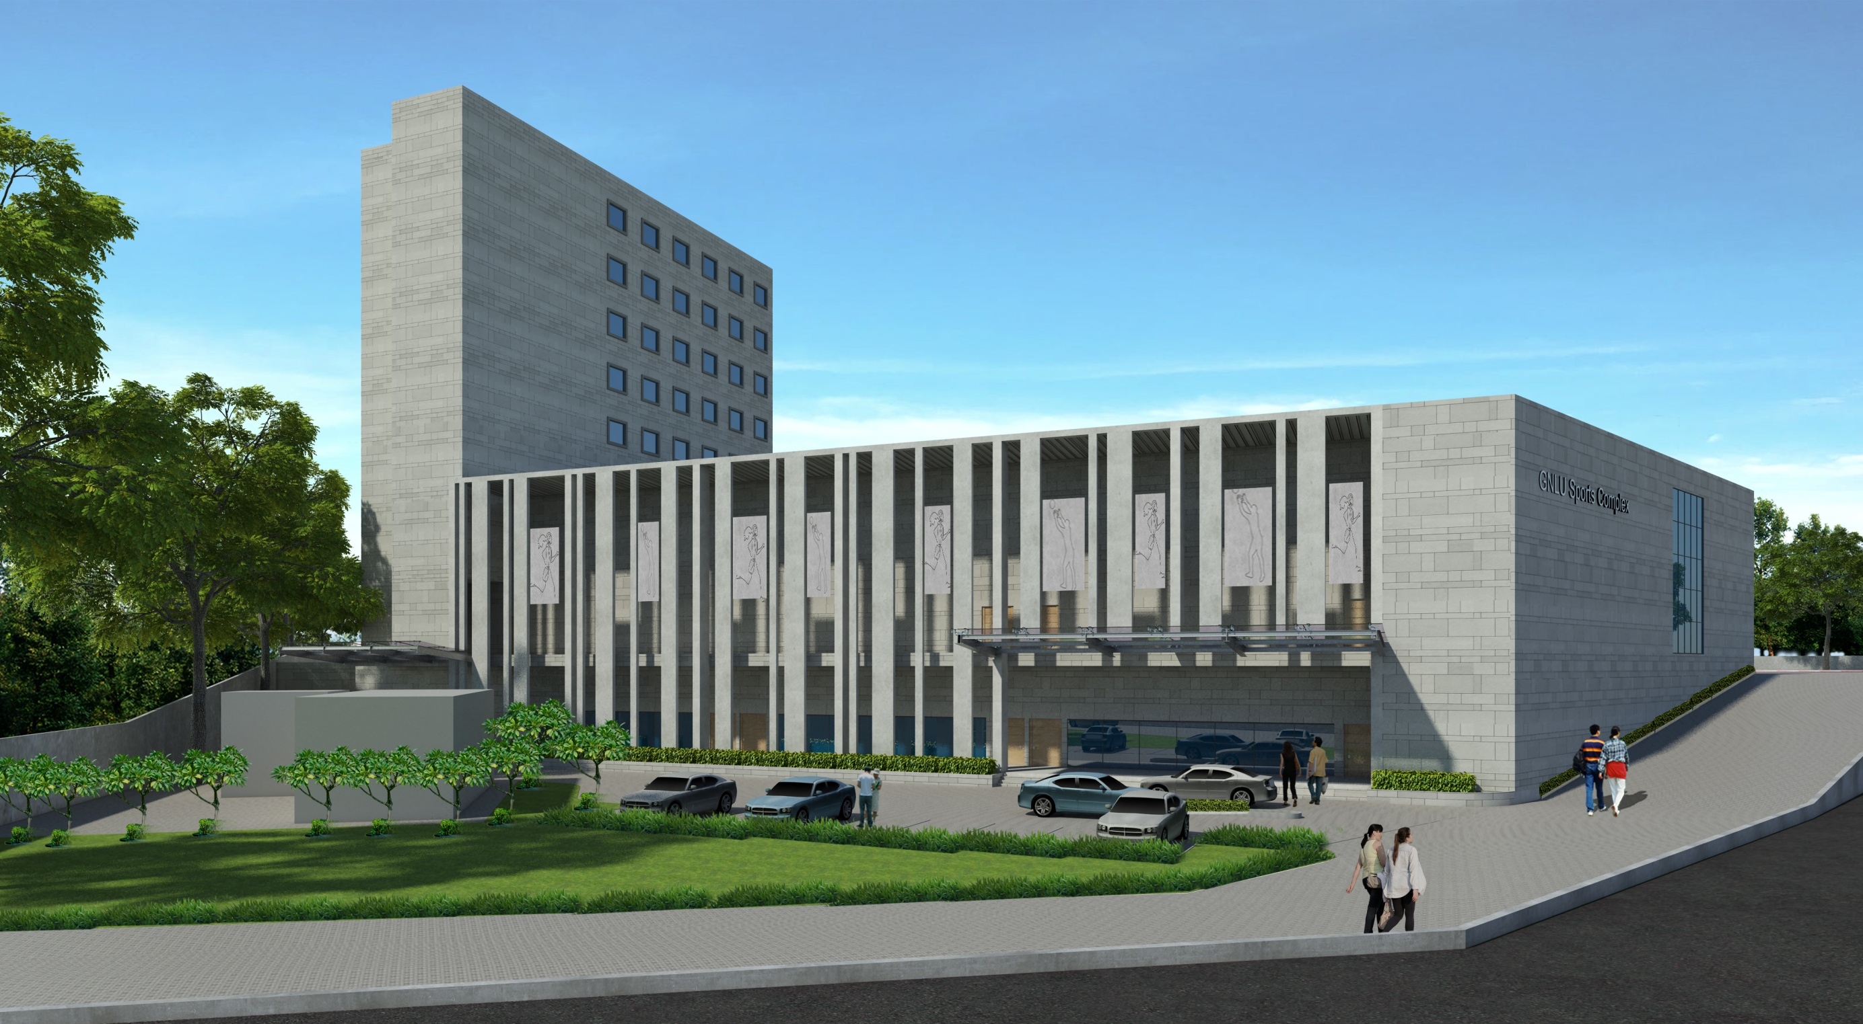
Sports complex

Slide 24
Indoor sports complex

Slide 25
Indoor sports complex _ Lower Ground Floor Plan
Secondary Entry/Exit
Existing
STP
+91.6m
+92.2m
Entry from upper ground level
Retaining wall
Retaining wall

Slide 26
Indoor sports complex _ Lower Ground Floor Plan _ Option 01
Residential
lobby
3.6m wide corridor
Duct
Physiotherapy
center
Indoor
games hall 01
Indoor
games hall 02
Up
Ele.
room
Multipurpose hall
For Practice/ yoga
aerobics etc
Classroom
Weightlifting
Karate
Indoor hall
for e-gaming
Shop for sports equipments
AV hall
Duct
Service duct
Store
Judo
Gymnasium
Boxing
Retaining wall
Up
2.0m wide corridor
Toilets
3m wide skylight
Retaining wall
Meeting room
Built-up area – 2915 Sq.m.

Slide 27
Indoor sports complex _ Lower Ground Floor Plan _ Option 02
Residential
lobby
Service duct
3.6m wide corridor
Duct
Indoor
games hall 01
Indoor
games hall 02
Up
Physiotherapy
center
Ele.
room
Multipurpose hall
For Practice/ yoga
aerobics etc
Classroom
Weightlifting
Karate
Indoor hall
for e-gaming
Shop for sports equipments
Up
AV hall
Duct
Meeting room
Boxing
Judo
Gymnasium
Retaining wall
2.0m wide corridor
Toilets
3m wide skylight
Retaining wall
Built-up area – 2915 Sq.m.

Slide 28
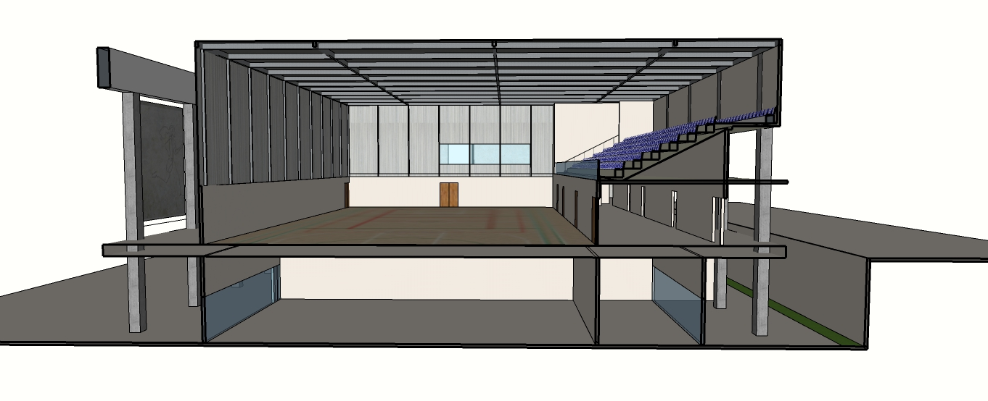
Multipurpose indoor hall design
Fabricate wall sheeting
PEB roof covering
Spectators’
seating
External façade in civil work and panels
9m
Storage space
Skylight
Towards athletic track
& outdoor sports
Towards secondary entry/ exit
Upper ground
at 95.5m
Indoor games hall
Lower ground
at 91.6m
3.6m wide corridor
10’ high dry wall partition
Seamless synthetic p
polyurethane Flooring
2m wide corridor

Slide 29
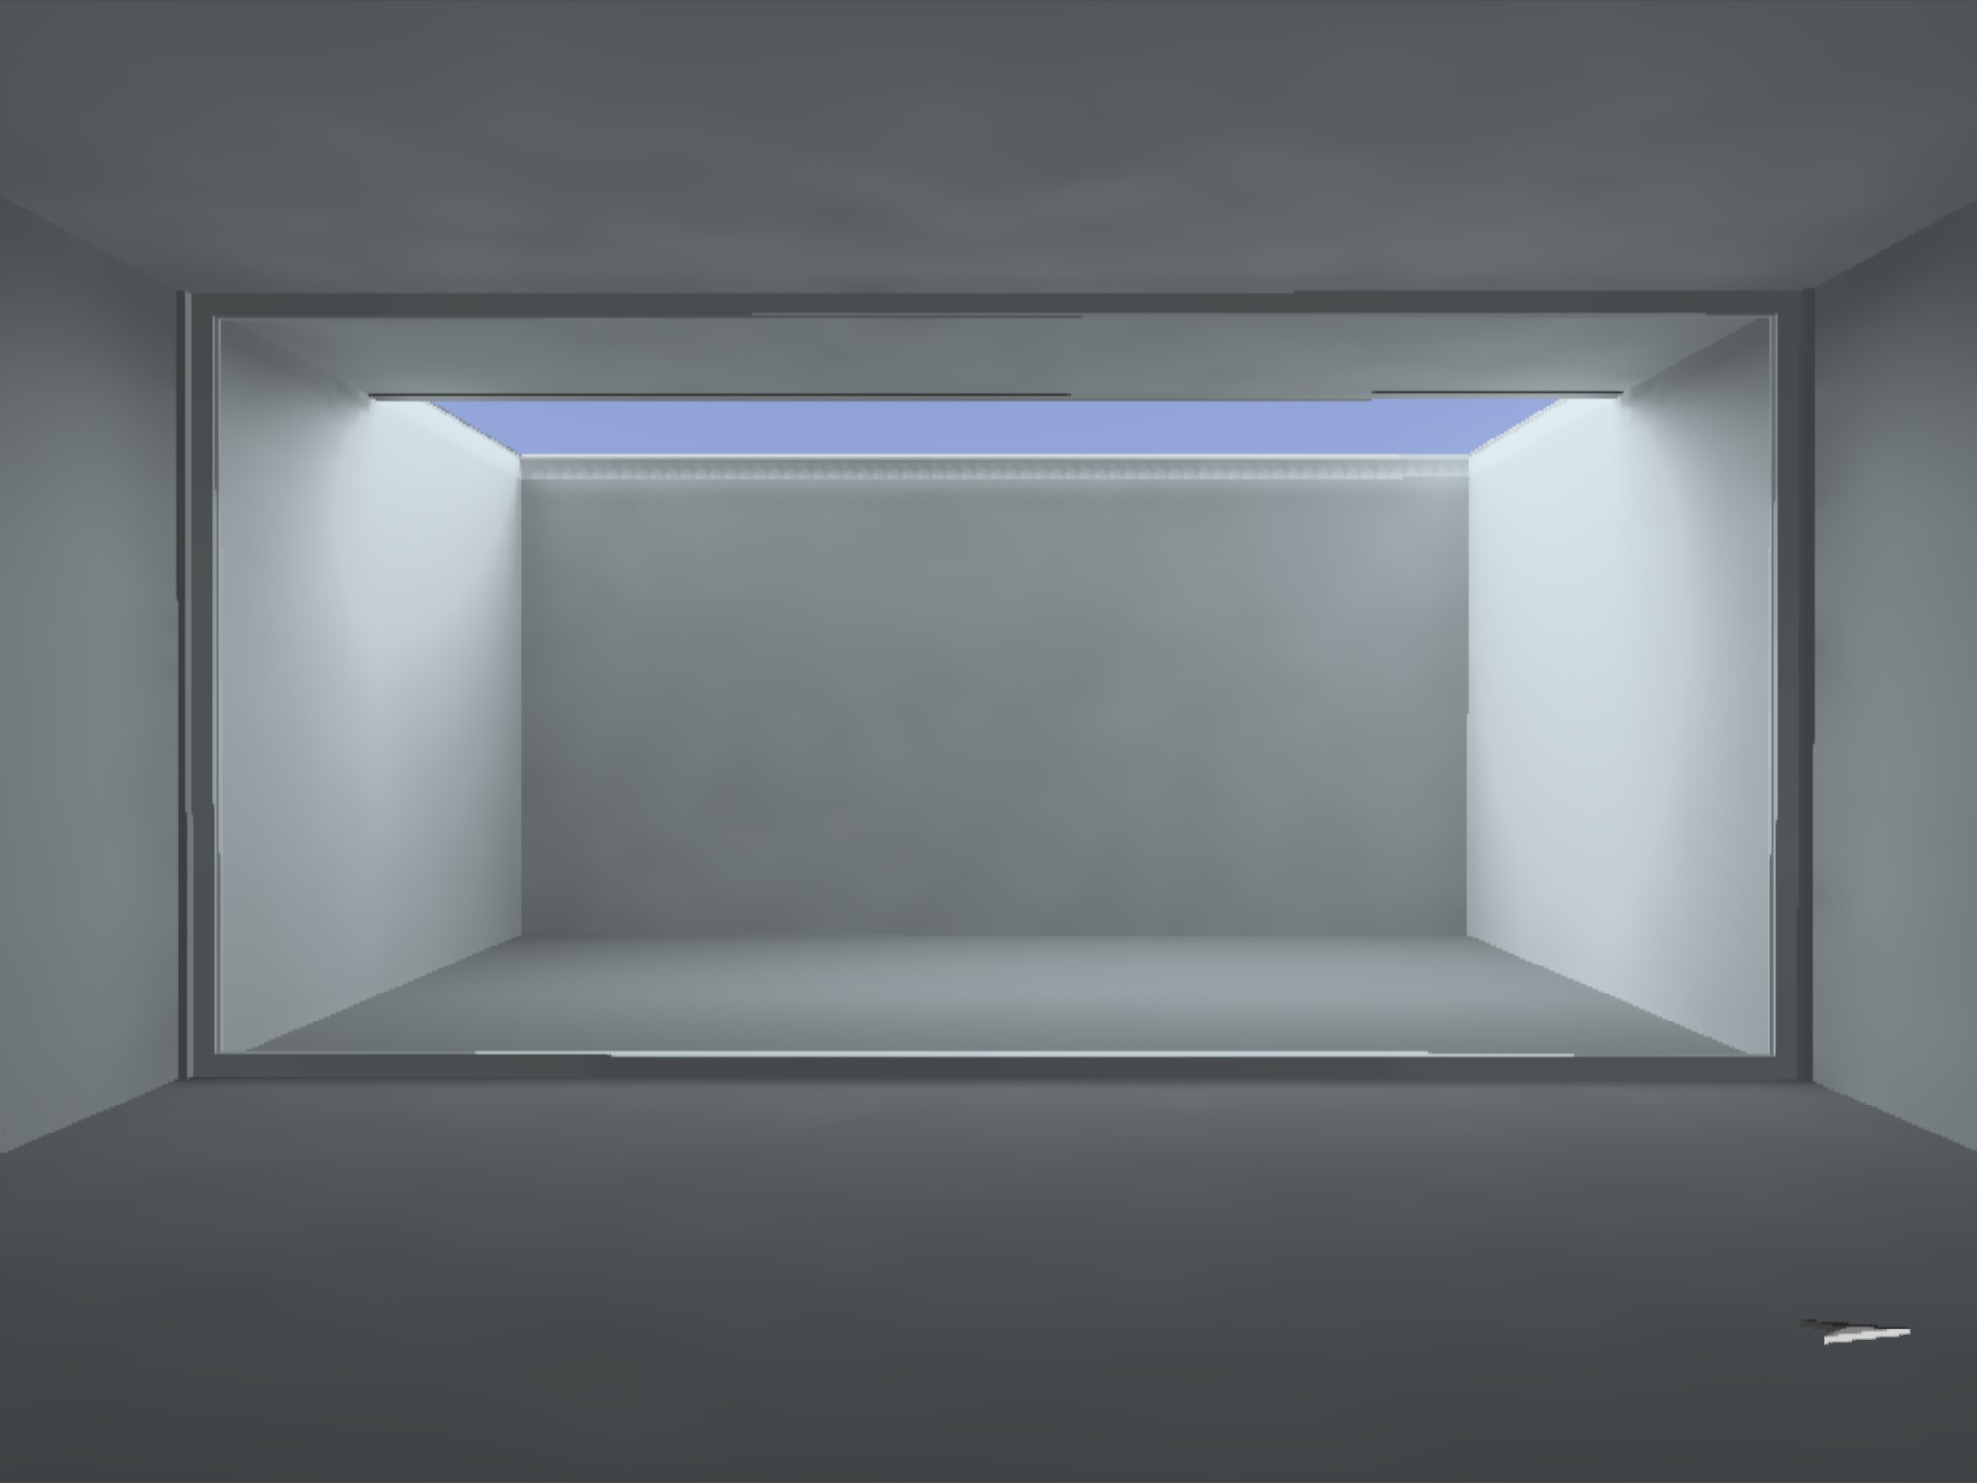
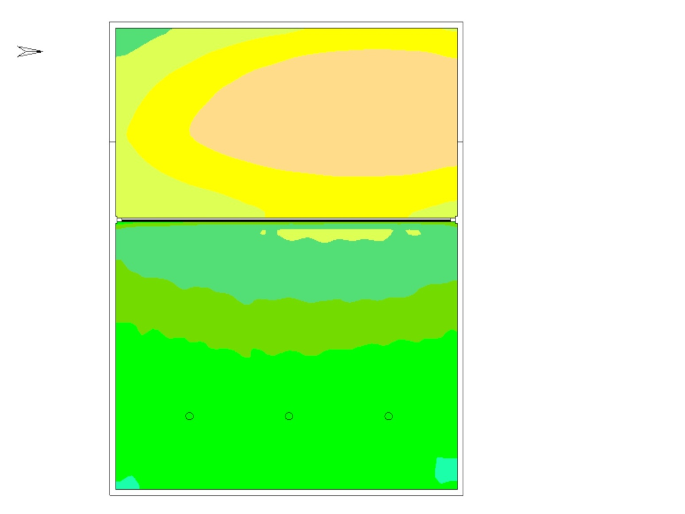
10:00 AM, December 2019
Lower ground - Daylight Analysis
100-200 lx
200-300 lx
300-500 lx
500-750 lx
750-1000 lx
1000-1250 lx
Daylight Analysis | DiaLux
Cut-out: 3m Wide

Slide 30
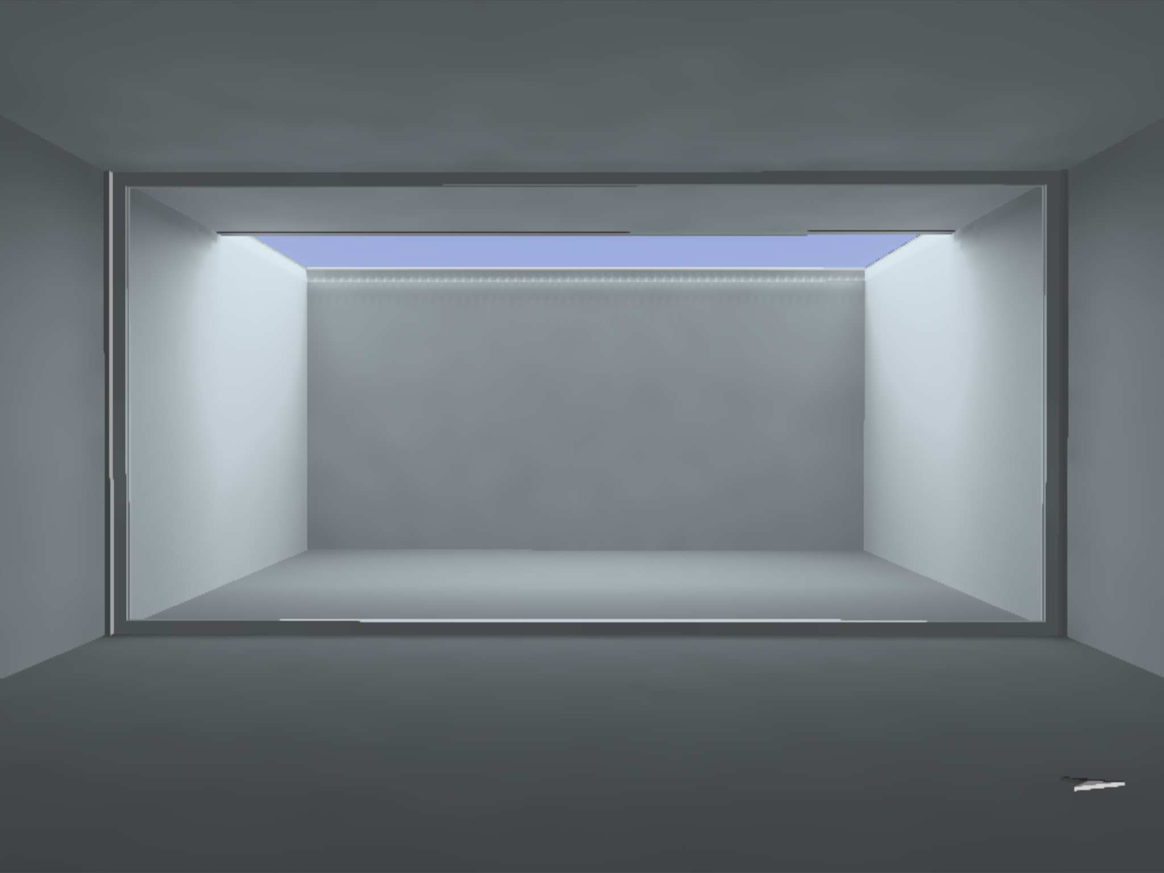
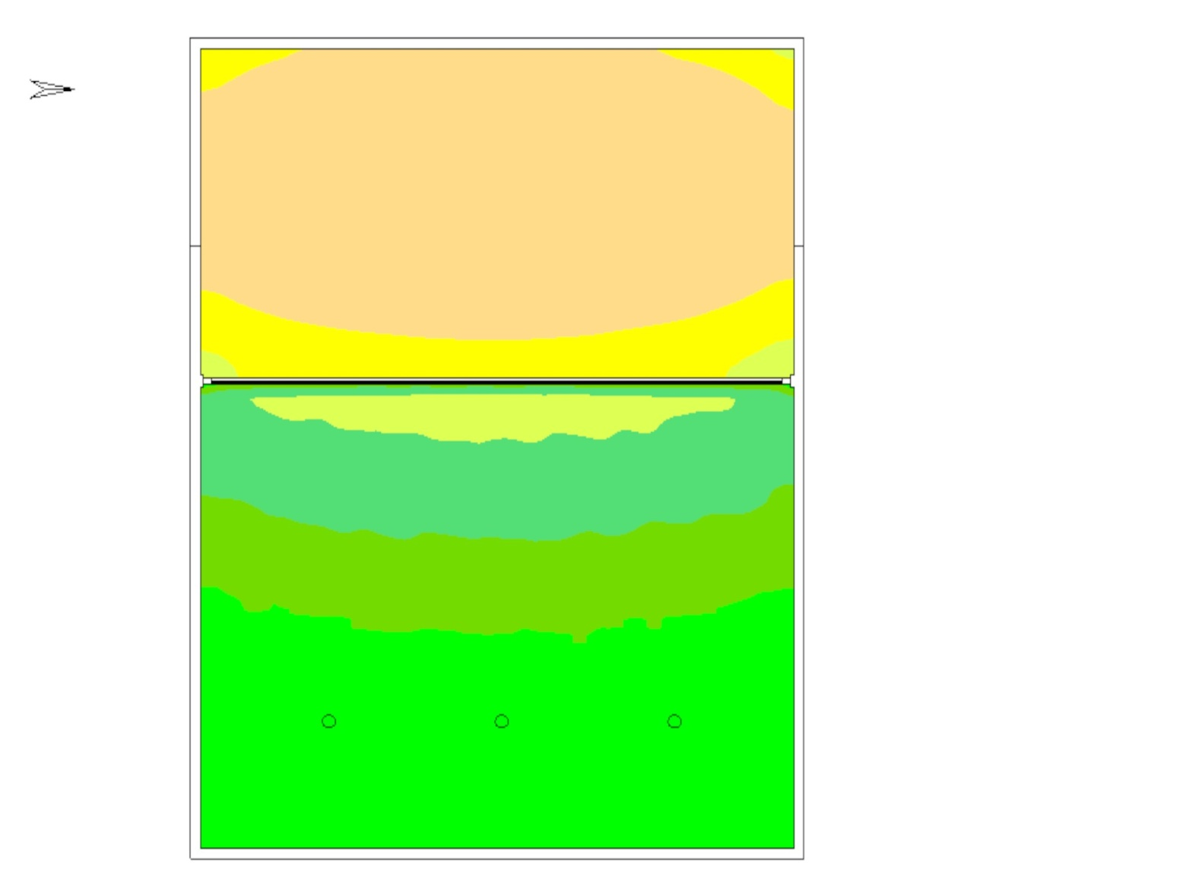
10:00 AM, June 2019
Lower ground - Daylight Analysis
100-200 lx
200-300 lx
300-500 lx
500-750 lx
750-1000 lx
1000-1750 lx
Daylight Analysis | DiaLux
Cut-out: 3m Wide

Slide 31
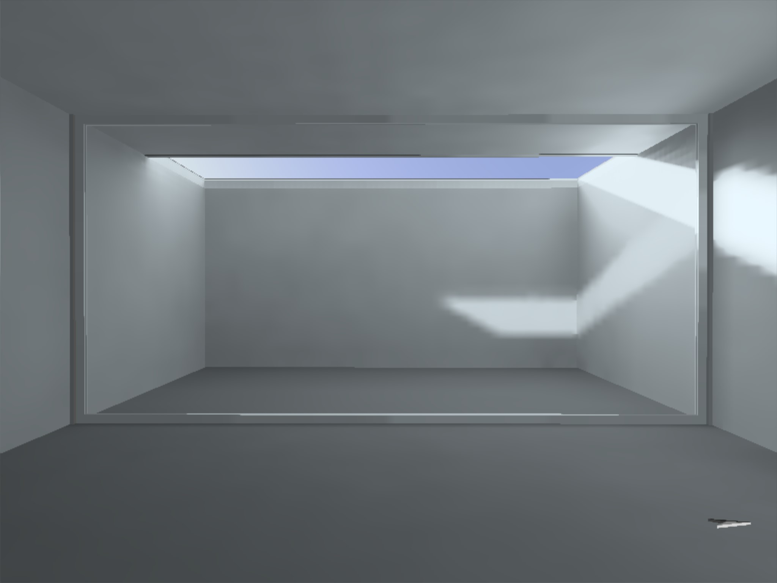
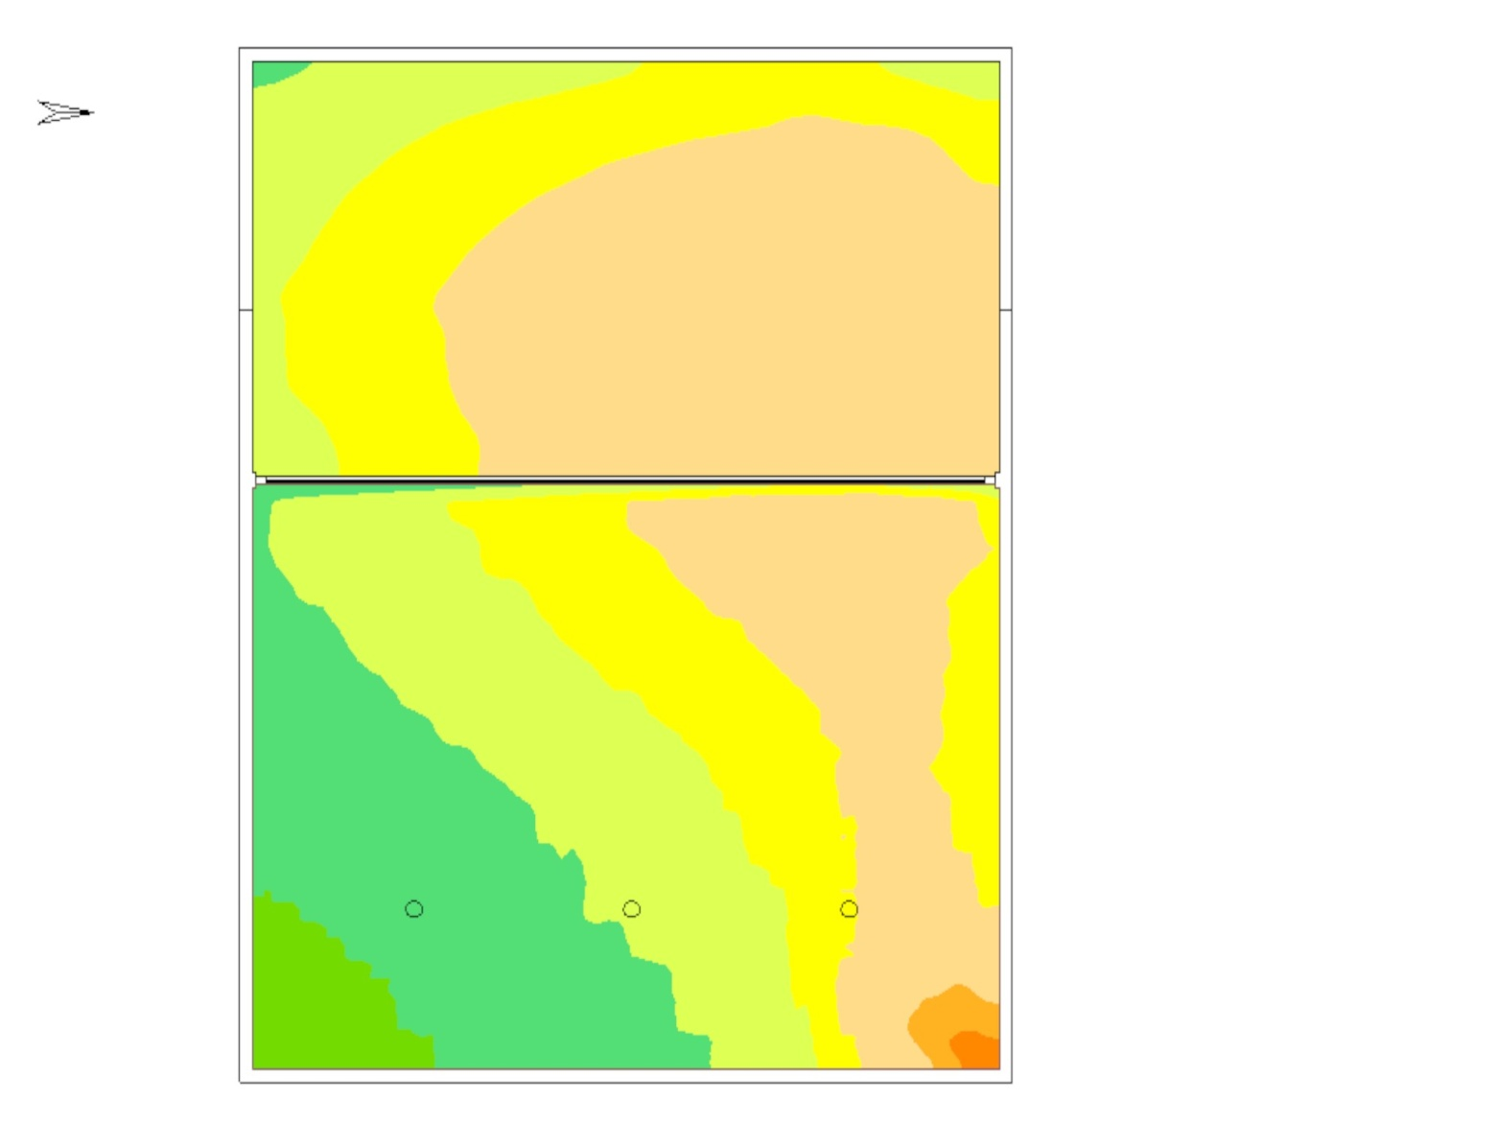
04:00 PM, December 2019
Lower ground - Daylight Analysis
200-300 lx
300-500 lx
500-750 lx
750-1000 lx
1000-1500 lx
2500-3000 lx
Daylight Analysis | DiaLux
Cut-out: 3m Wide

Slide 32
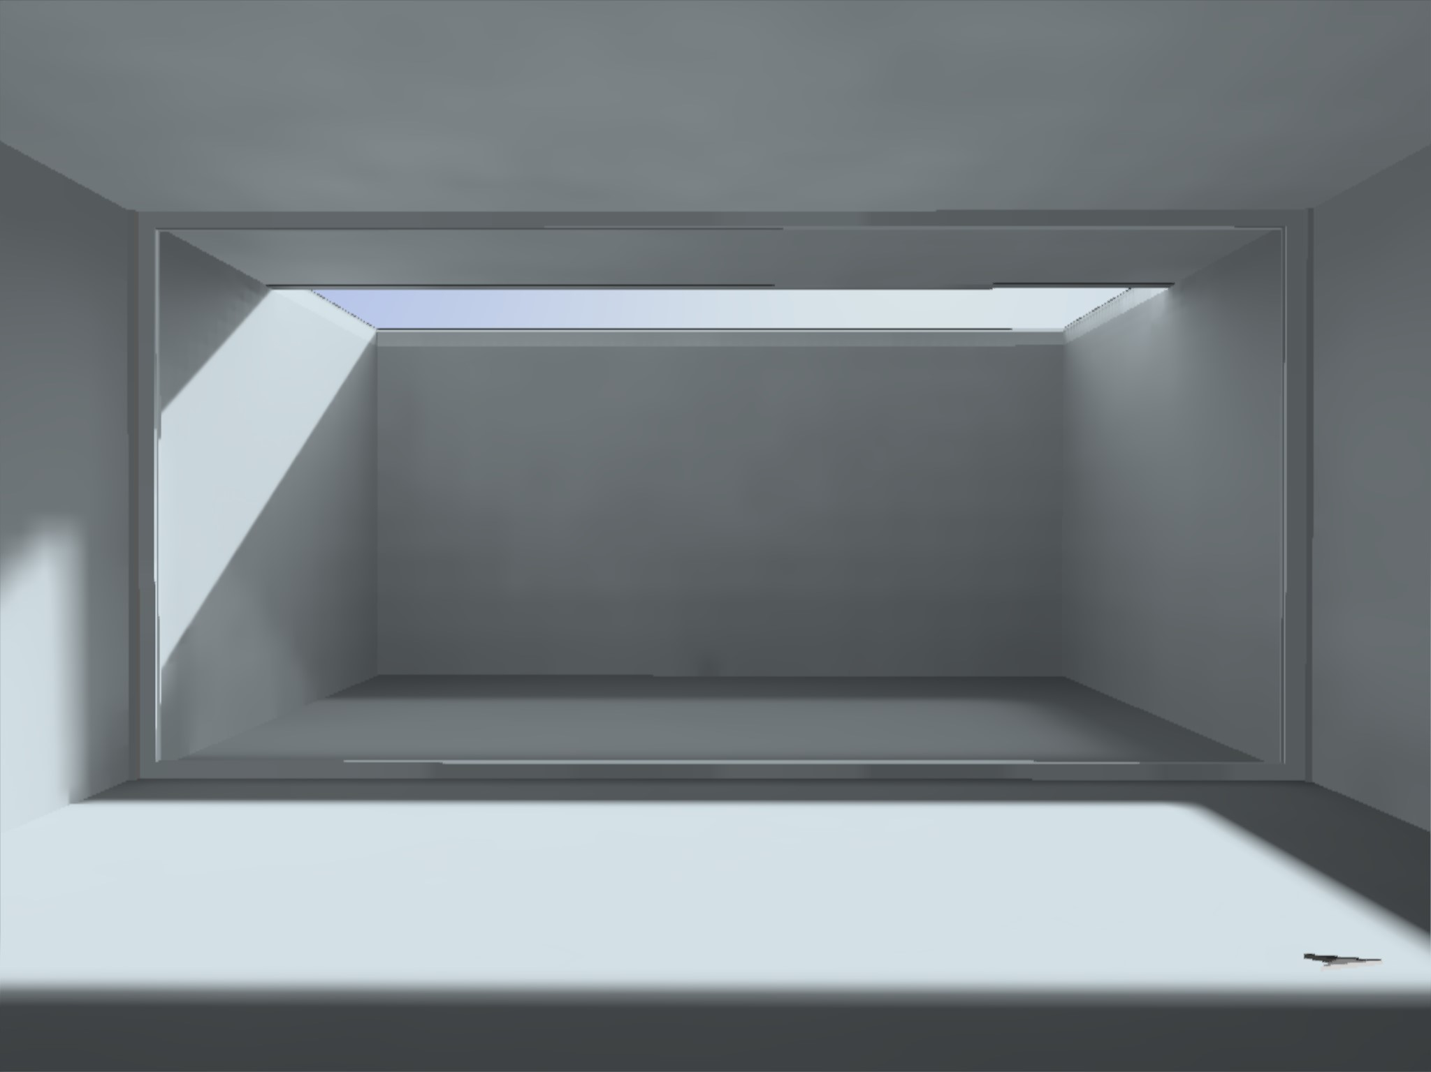
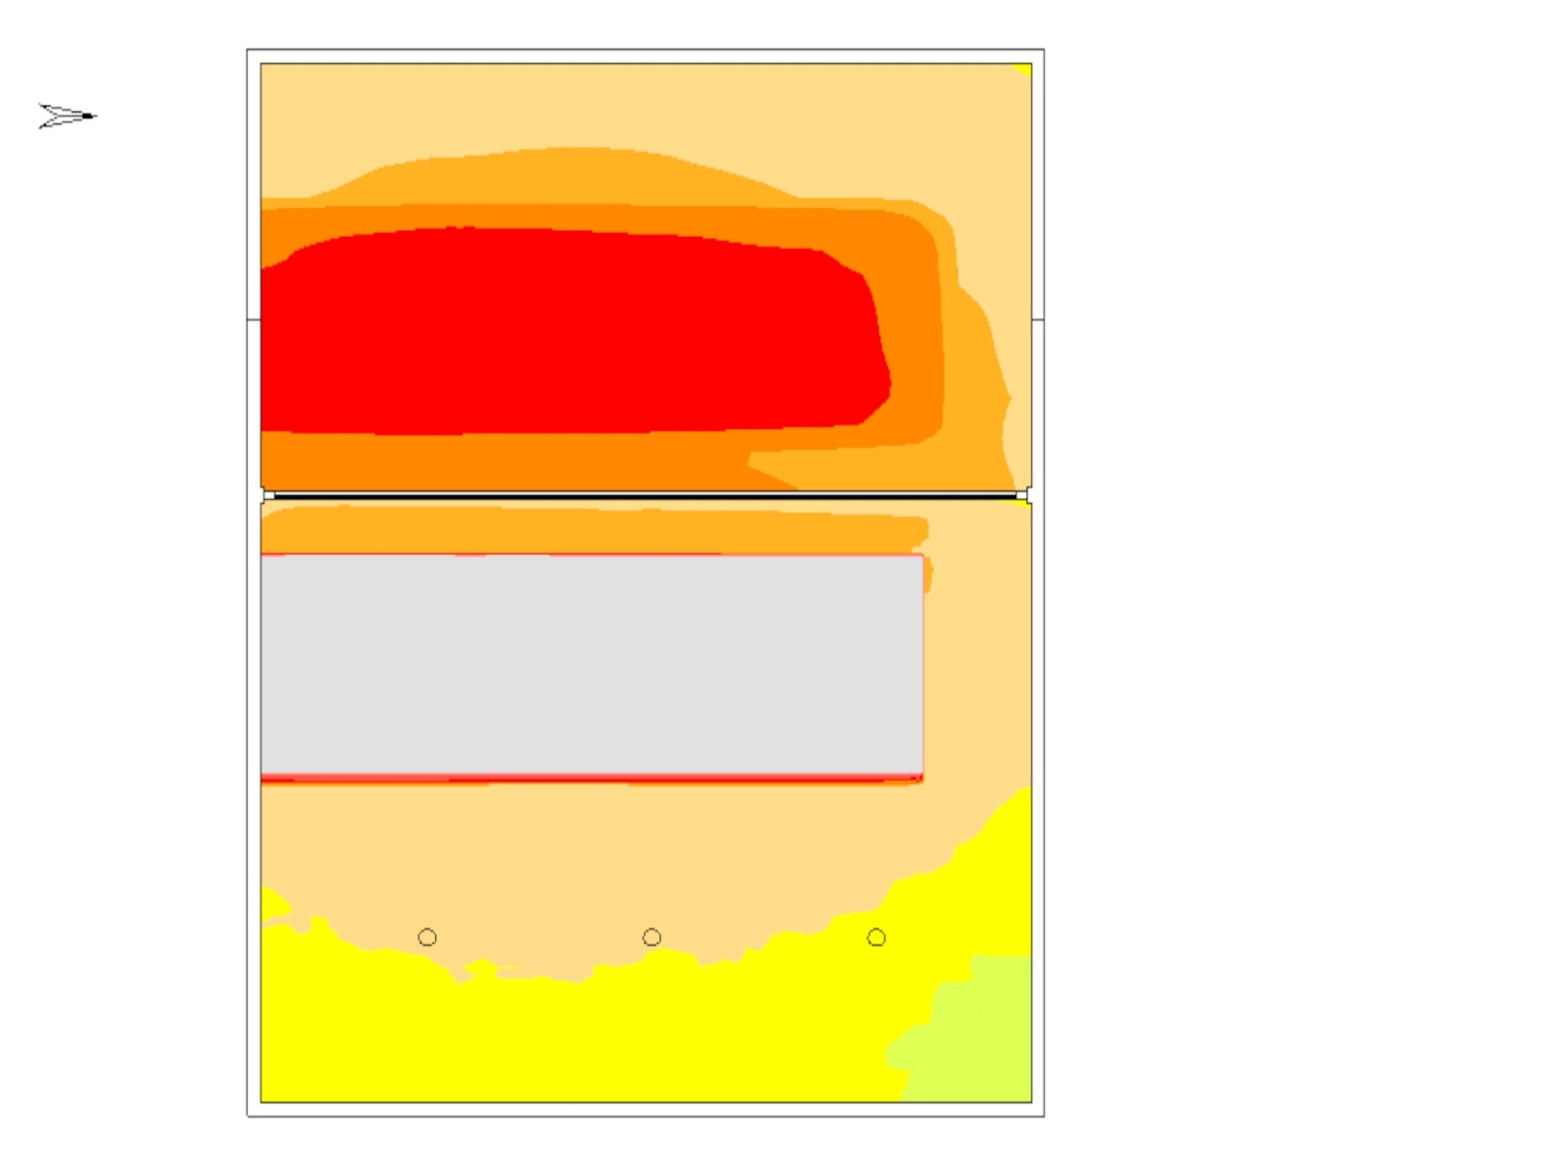
04:00 PM, June 2019
Lower ground - Daylight Analysis
Direct Light
500-750 lx
750-1000 lx
1000-2000 lx
2000-3000 lx
3000-5000 lx
5000-6000 lx
Daylight Analysis | DiaLux
Cut-out: 3m Wide

Slide 33
Indoor games standards

Slide 34
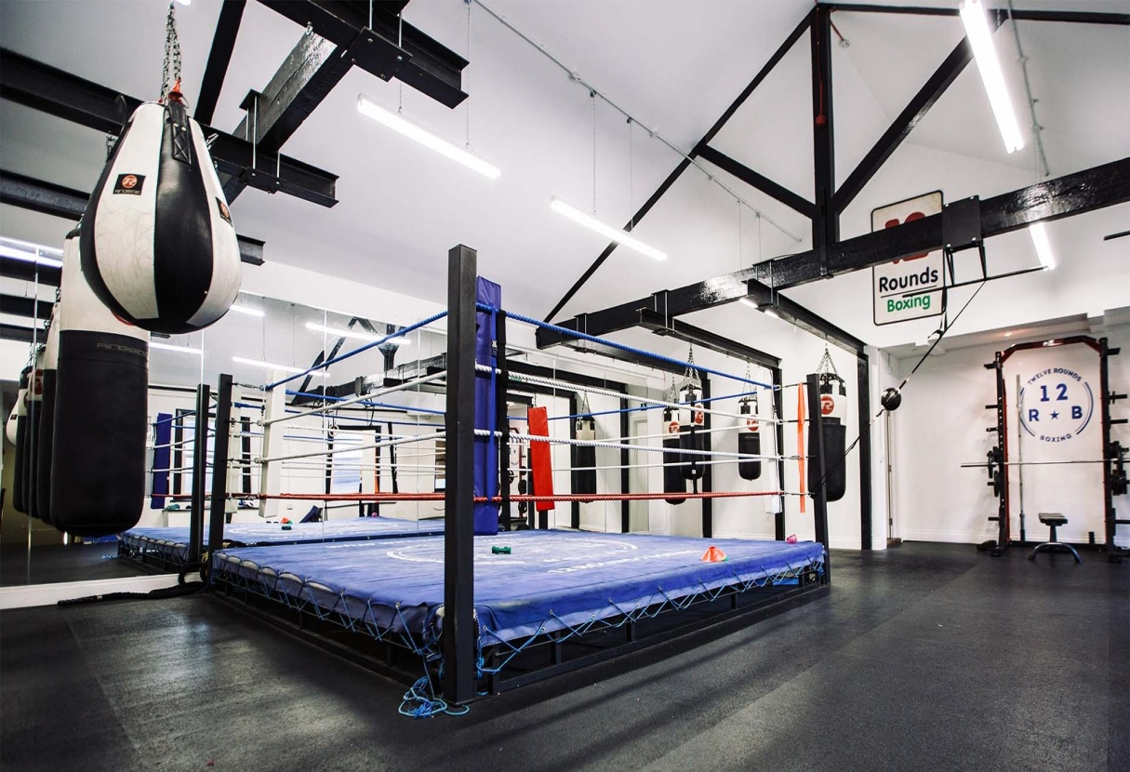
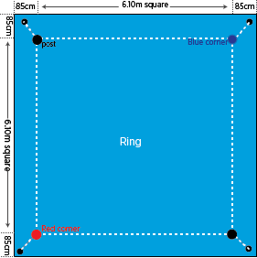
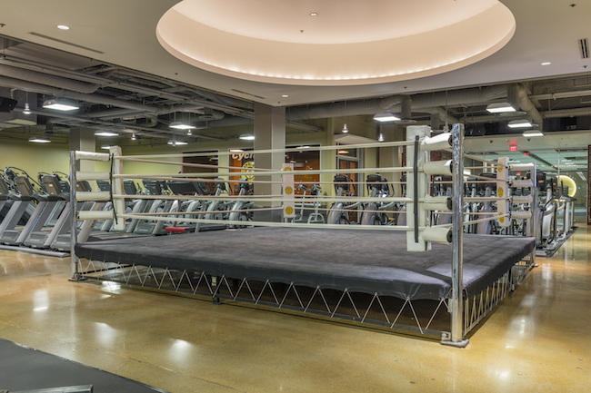
References
Boxing

Slide 35
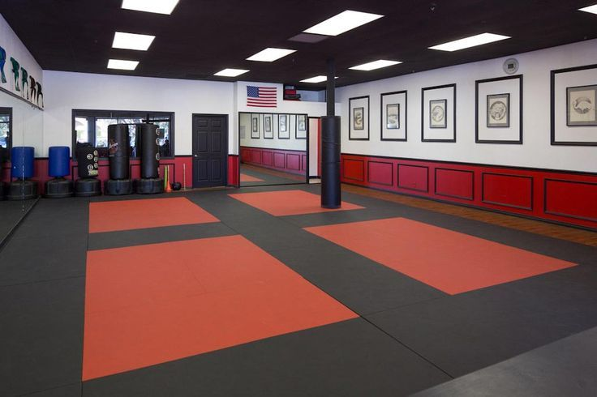
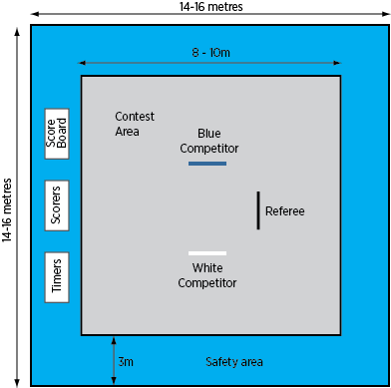
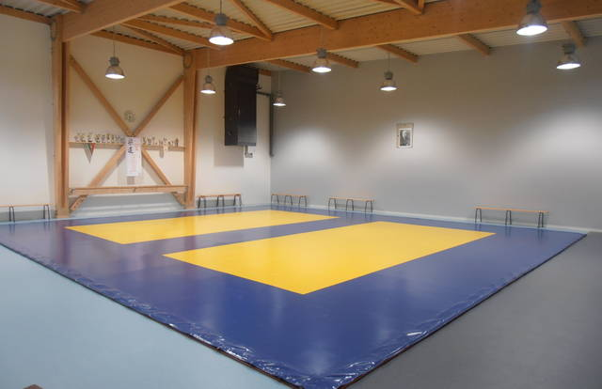
References
Judo

Slide 36
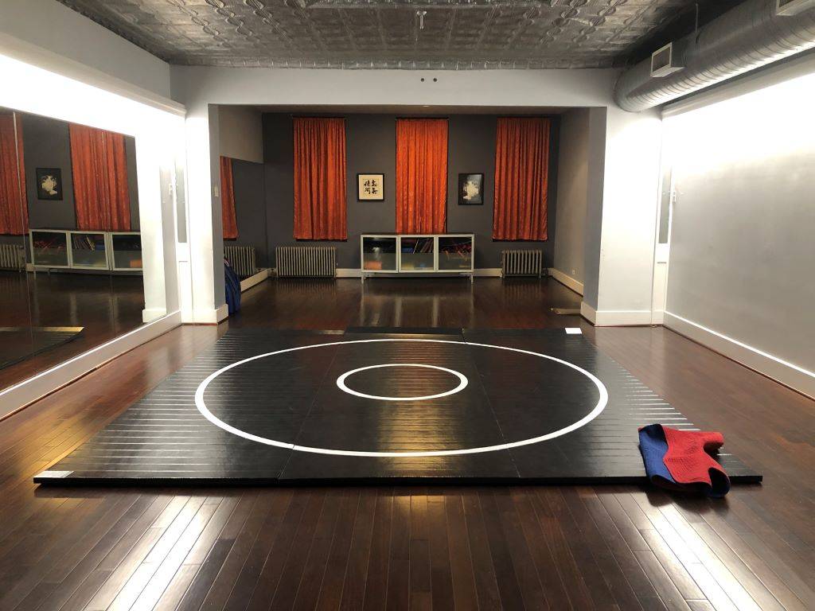
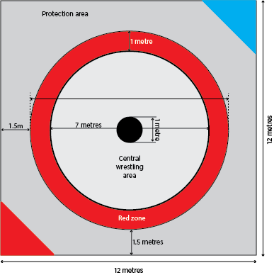
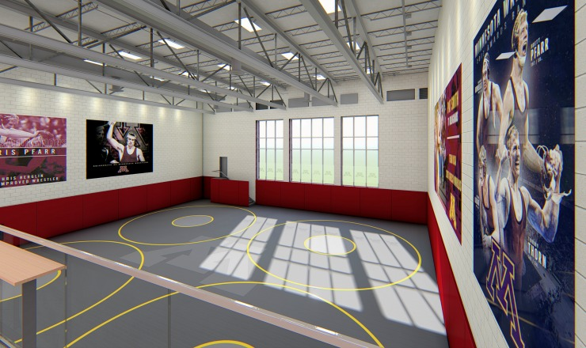
References
Wrestling

Slide 37
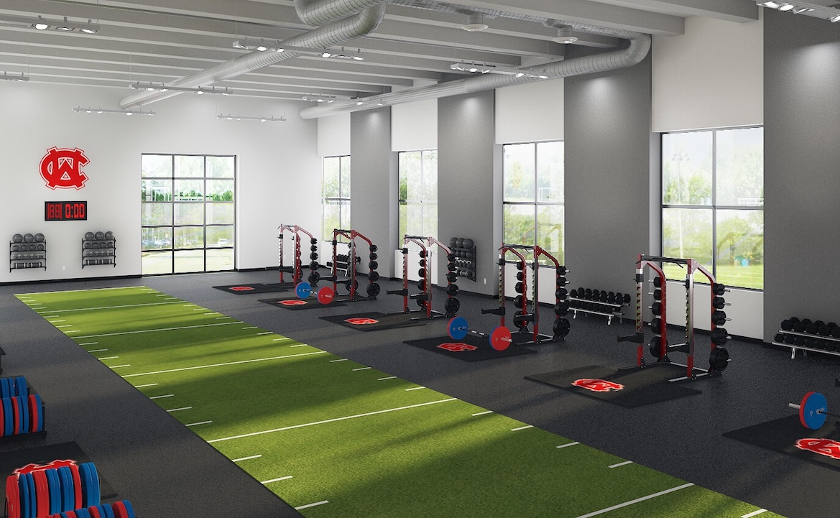
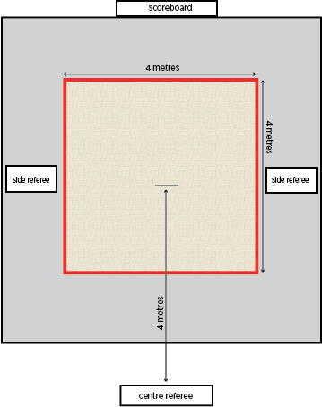
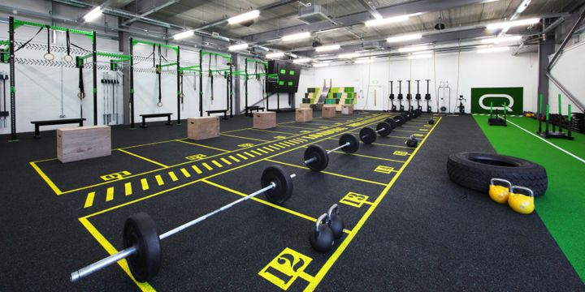
References
Weightlifting

Slide 38
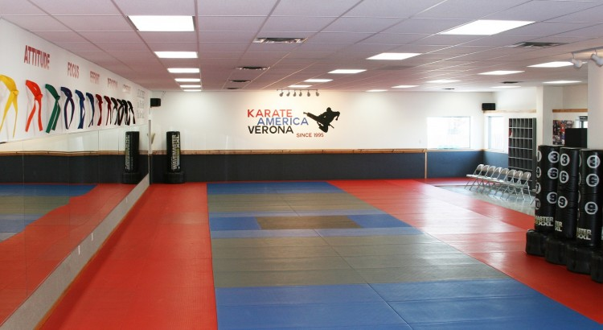
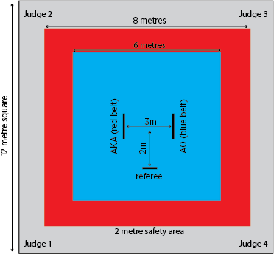
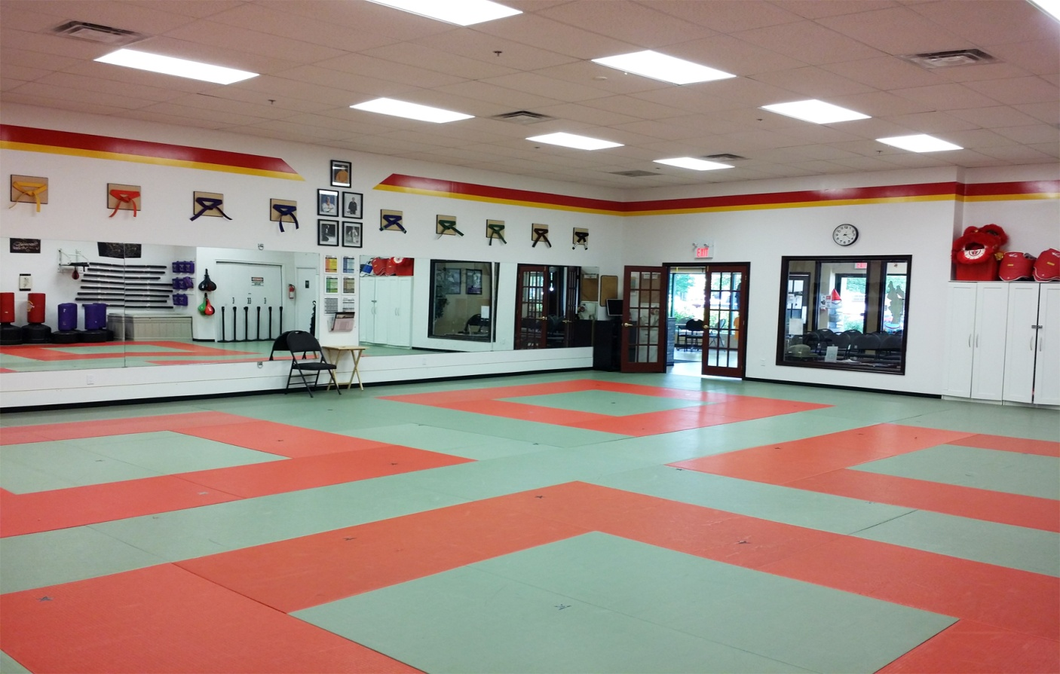
References
Karate

Slide 39
Indoor sports complex _ Upper Ground Floor Plan_Option 01
Residential
lobby
Duct
3.6m wide corridor
Ele.
room
Towards lower ground
7.5 m wide road
Multipurpose indoor hall
(6 badminton court)
Slope 1:7
51.450m x 20.050m x 9m ht
Kitchen
Multi purpose room
Duct
Reception
& waiting
Canteen
+96.7m
Service duct
Outdoor seating
Office
Up
4.2m wide corridor
3m wide skylight
+95.5m
Handicapped ramp
Dressing Room
(F) (M)
Referee
lounge
Store
Dressing Room
(F) (M)
Common
toilet
Built-up area – 2768 Sq.m.

Slide 40
Indoor sports complex _ Upper Ground Floor Plan_Option 02
Service duct
Residential
lobby
Duct
3.6m wide corridor
Ele.
room
Towards lower ground
7.5 m wide road
Slope 1:7
Multipurpose indoor hall
(6 badminton court)
Up
51.450m x 20.050m x 9m ht
Kitchen
Multi purpose room
Reception
& waiting
Duct
Canteen
+96.7m
Office
Outdoor seating
4.2m wide corridor
Handicapped ramp
3m wide skylight
+95.5m
Dressing Room
(F) (M)
Referee
lounge
Store
Tournament room
Dressing Room
(F) (M)
Common
toilet
Built-up area – 2768 Sq.m.

Slide 41
Proposed Multipurpose sports hall (51.450m x 20.050m x 9m ht)
Type and numbers of sports can be played at a time
Badminton (6.1x13.4m) – 6nos.
Volleyball (18x9m) – 1 no. + Badminton (6.1x13.4m) – 3nos.

Slide 42
Proposed Multipurpose sports hall (51.450m x 20.050m x 9m ht)
Type and numbers of sports can be played at a time
Basketball (28x15m) – 1no. + Badminton (6.1x13.4m) – 2nos.
Or Netball (30.5x15.3m) – 1no.
Table tennis – 9 nos. + Badminton (6.1x13.4m) – 3nos.
Or Volleyball (18x9m) – 1 no.

Slide 43
Proposed Multipurpose sports hall (51.450m x 20.050m x 9m ht)
Type and numbers of sports can be played at a time
Basketball (25x14m) – 1no. + Volleyball (18x9m) – 1 no.
Basketball (25x14m) – 2nos. or Volleyball (18x9m) – 2 nos.

Slide 44
Proposed Multipurpose sports hall (51.450m x 20.050m x 9m ht)
Type and numbers of sports can be played at a time
Basketball (25x14m) – 1no. + Gymnastic– 1no. + Judo – 1 no.
or Volleyball (18x9m) – 1 no.
Badminton (6.1x13.4m) – 3nos + Gymnastic– 1no. + Judo – 1 no.

Slide 45
Proposed Multipurpose sports hall norms as per Sports authority of India (SAI)
Flooring = seamless synthetic polyurethane
False ceiling provided only if the hall is air conditioned.
MP hall should be air conditioned only if it is proposed for National level competitions.
Extra zone - margin area around play field for team benches, spectators and officials table.
· Security zone - area between teams and spectators, required for major events.
· MP halls are designed of multiple of size of badminton court.
· Structure and light fitting should be placed as per layout of badminton courts.

Slide 46
Indoor sports complex _ First Floor Plan_Option 01
Duct
Store
Ele.
room
Common
room
Meeting room
Girls dormitory
(26 girls)
VIP viewing galley
Viewing galley
Service duct
Dn
4.2m wide corridor
VIP
Lounge
Girls dormitory
(38 girls)
Spectators’ seating 500pax
Toilets
Built-up area – 1540 Sq.m.

Slide 47
Indoor sports complex _ First Floor Plan_Option 02
Service duct
Duct
Store
Ele.
room
Common room
Meeting room
Girls dormitory
(26 girls)
VIP viewing galley
Viewing galley
Dn
4.2m wide corridor
VIP
Lounge
Girls dormitory
(38 girls)
Spectators’ seating 560pax
Toilets
Built-up area – 1540 Sq.m.

Slide 48
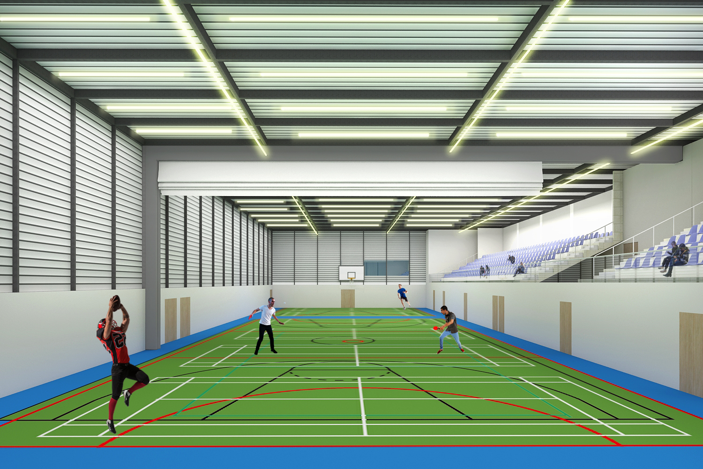
Multipurpose indoor hall – Internal View

Slide 49
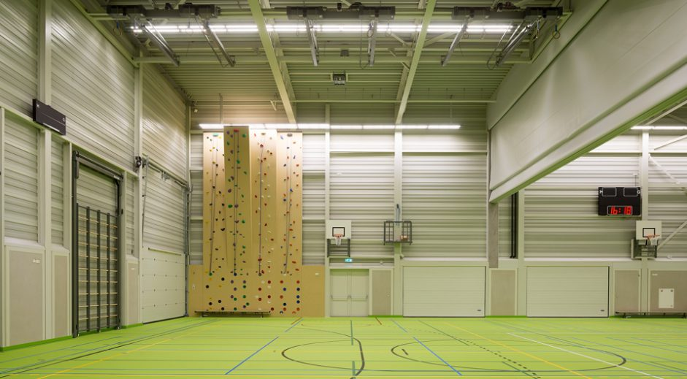
References
Multipurpose court
Fabricate wall sheeting
Retractable partition

Slide 50
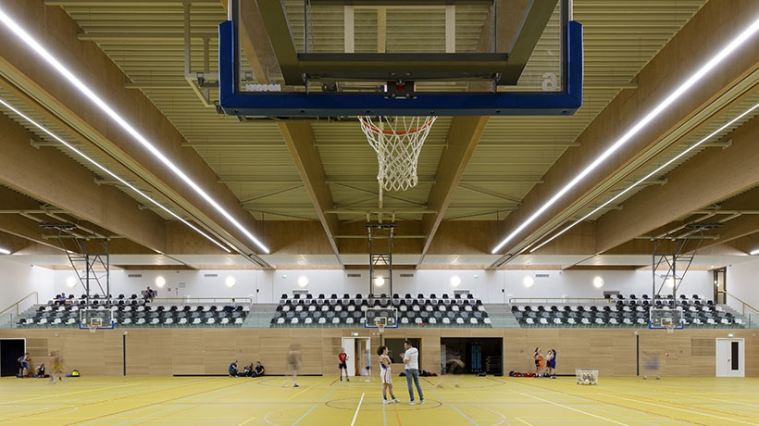
References
Multipurpose court
Spectators’ seating at 1st level
Rooms at ground level

Slide 51
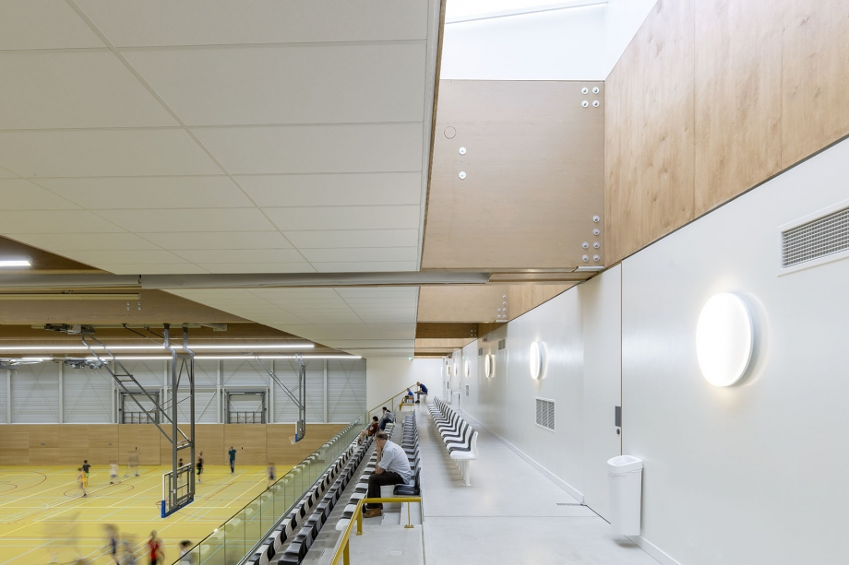
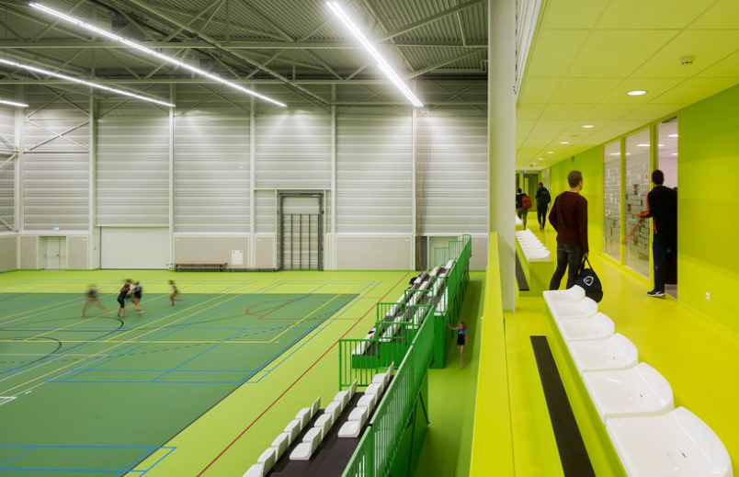
References
Multipurpose court - Spectators’ seating at 1st level

Slide 52
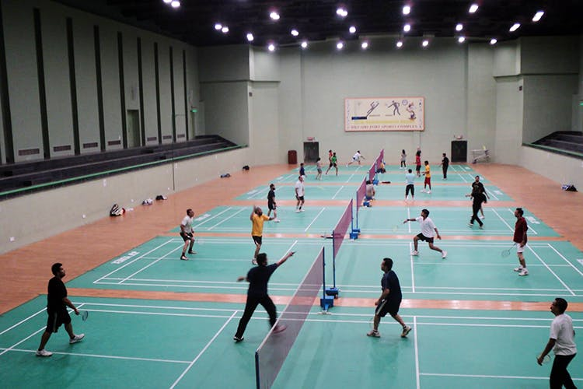
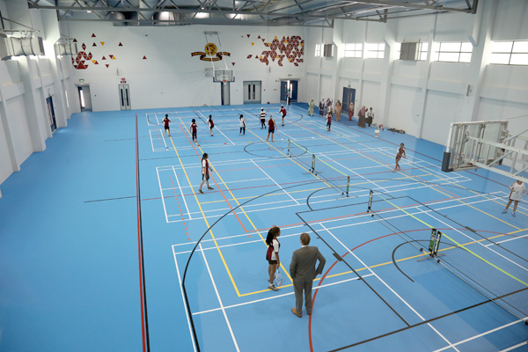
References
Multipurpose court - Sports activity

Slide 53
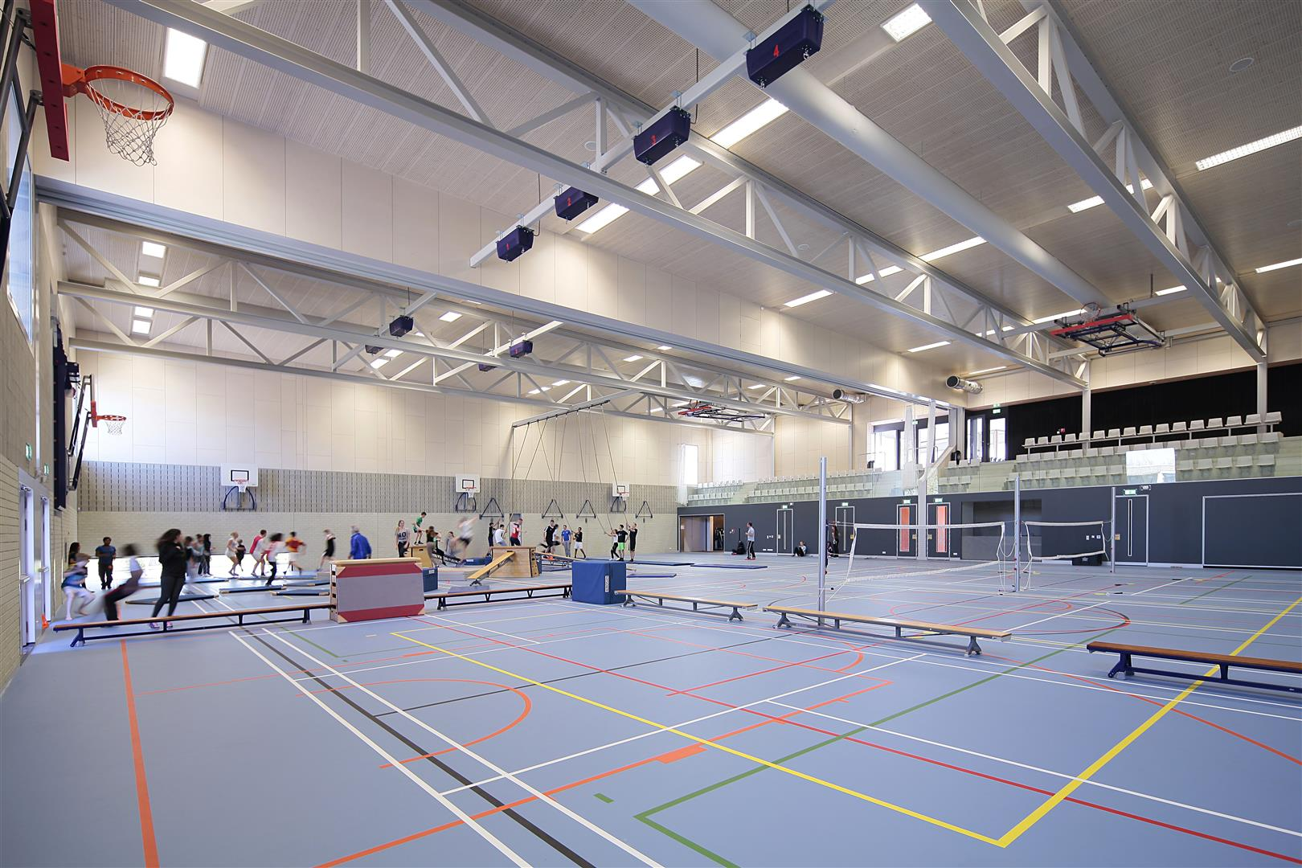
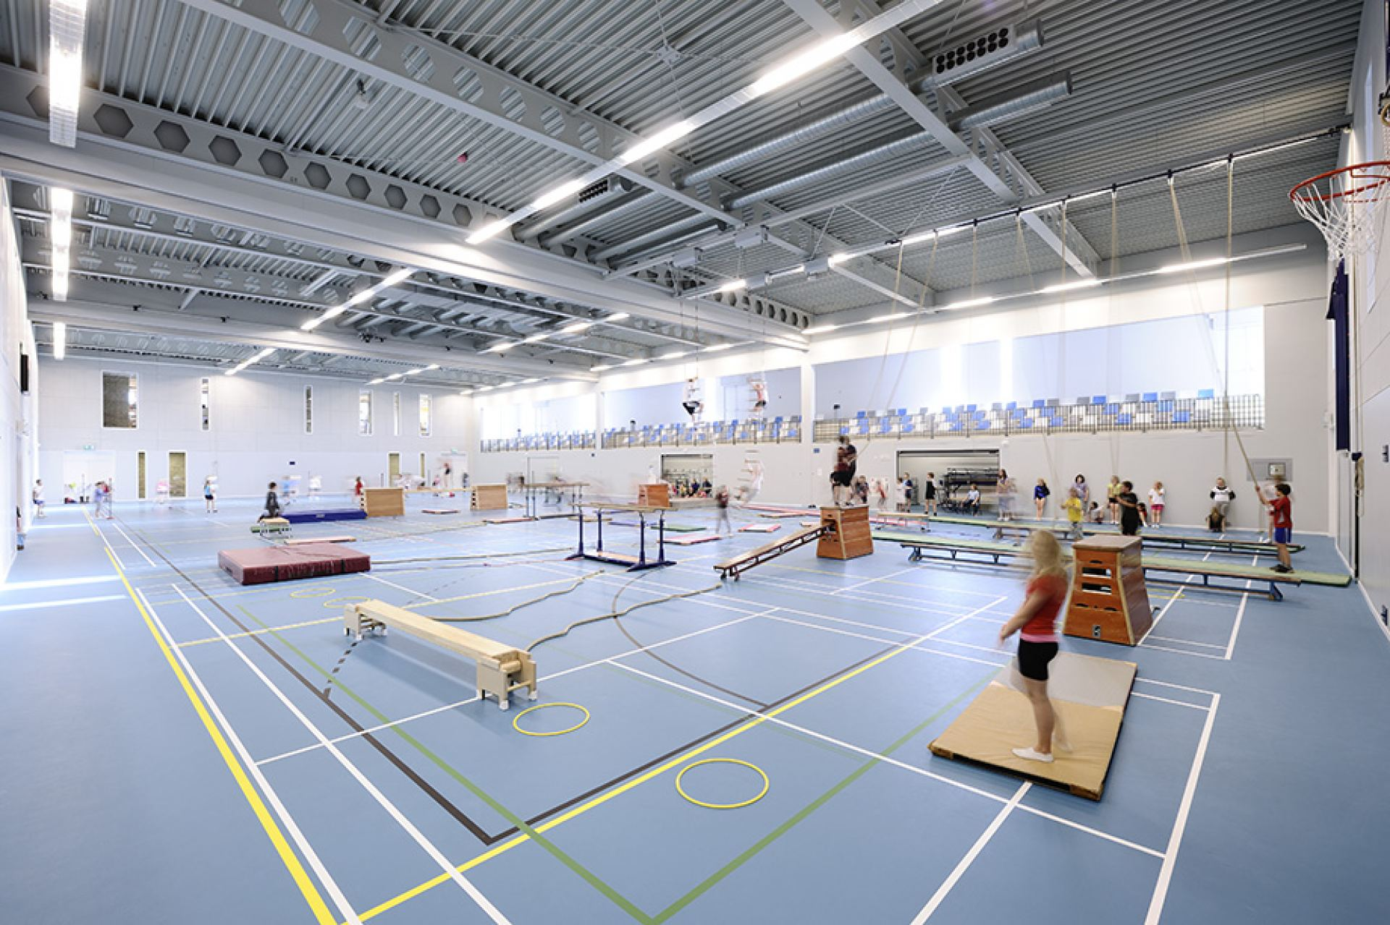
References
Multipurpose court - Alternative use

Slide 54
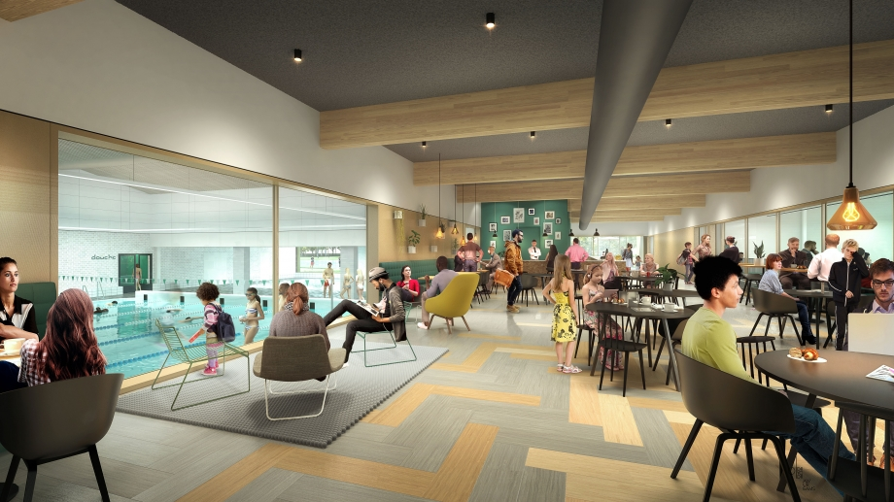
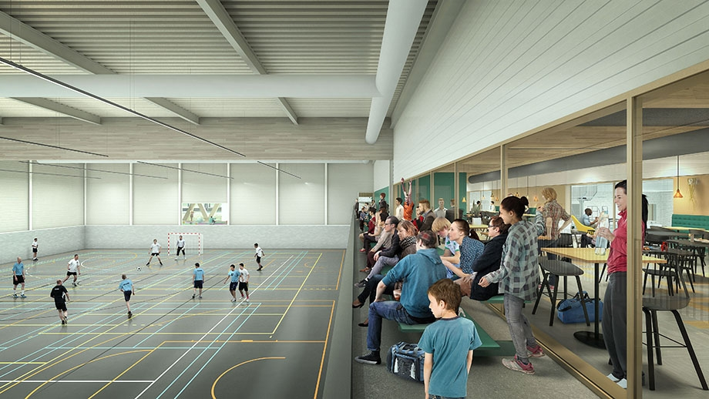
References
Canteen/ recreational activity along with indoor sports

Slide 55
Indoor sports complex _ Second Floor Plan
Store
Common room
Boys dormitory
(26 boys)
5.2m wide corridor
Boys dormitory
(38 boys)
Built-up area –558 Sq.m.

Slide 56
Indoor sports complex
Third Floor Plan
VIP Accommodation
Fourth to Seventh Floor plan – typical
Players Accommodation
Store
Lobby
2.5m wide corridor
2.5m wide corridor
9 single sharing room
Two suite rooms
13 two sharing room per floor
Total 52 rooms
Built-up area per floor – 558 Sq.m.

Slide 57
Swimming pool

Slide 58
Indoor sports complex

Slide 59
Swimming pool plan
Pump room
Lobby
25m
6m wide internal road
50m
Spectators’ seating 200 pax
Changing and
shower Room (M)
Changing and
shower room (F)

Slide 60
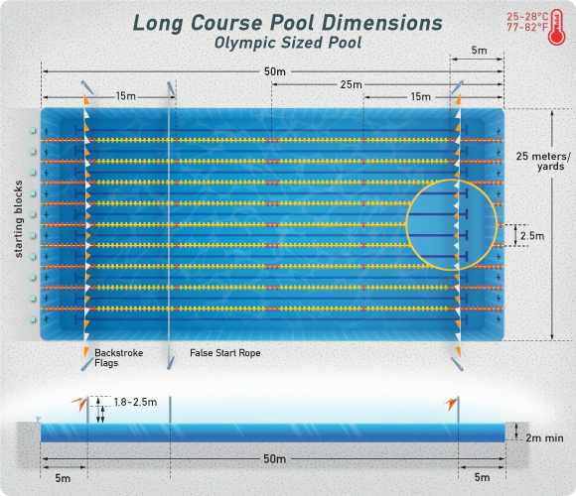
Swimming pool norms as per SAI & FINA: Federation International de National Amateur (FINA)
Length and width - 50 x 25m
Depth - 2 m
Starting platform - 0.5m to 0.75m from the
water surface. Surface area - 0.5 x 0.5m

Slide 61
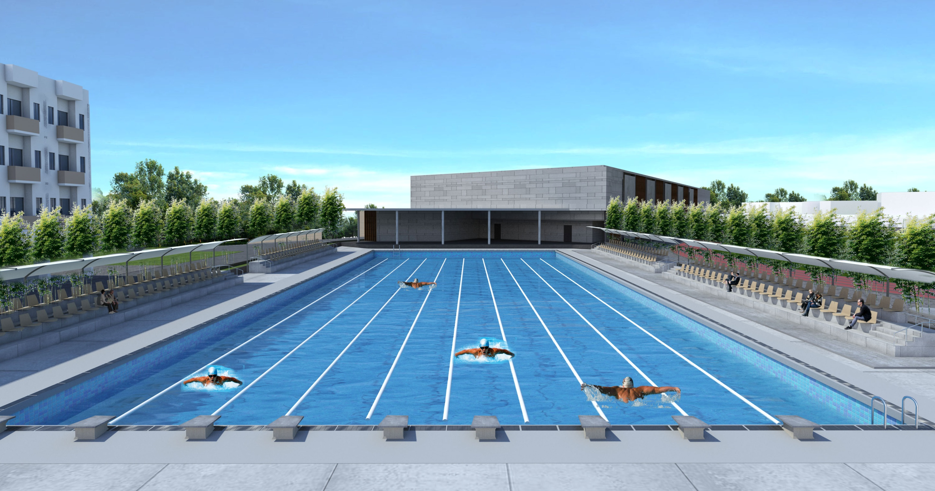
Swimming pool

Slide 62
400m Synthetic Athletics Track

Slide 63
400m Synthetic Athletics Track

Slide 64
400m Synthetic Athletics Track
8m space for Jump facility
400m athletic running track
7.5m wide road
+95.0m
8m wide road
Kabaddi
13m x 10m
6m wide road
Lawn
Tennis
23.7m x 10.9m
Kho-kho
29m x 16m
Volleyball
18m x 9m
Pre functional
area
Football pitch – 90m x 45m
4.5m wide road
Spectators’ seating
approx for 500 pax

Slide 65
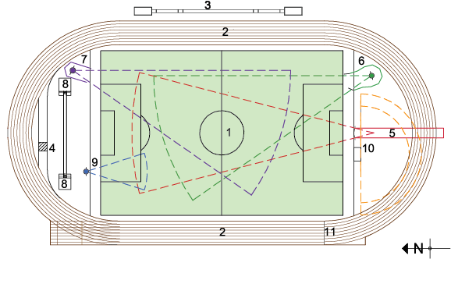
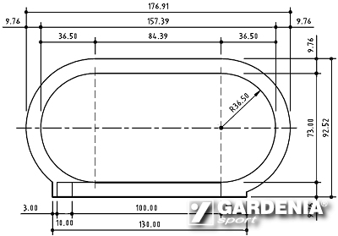
Athletic tracks and outdoor play fields
Track and field events are divided into three
broad categories:
track events
field events,
combined events
Football pitch
Standard track
Long and triple Jump facility
Water Jump
Javelin throw facility
Discus and Hammer throw facility
Discus throw facility
Pole vault facility
Shot put facility
High Jump facility
Finish line

Slide 66
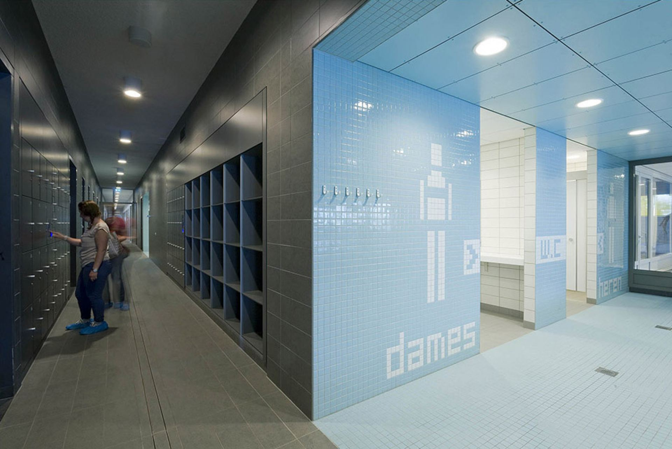
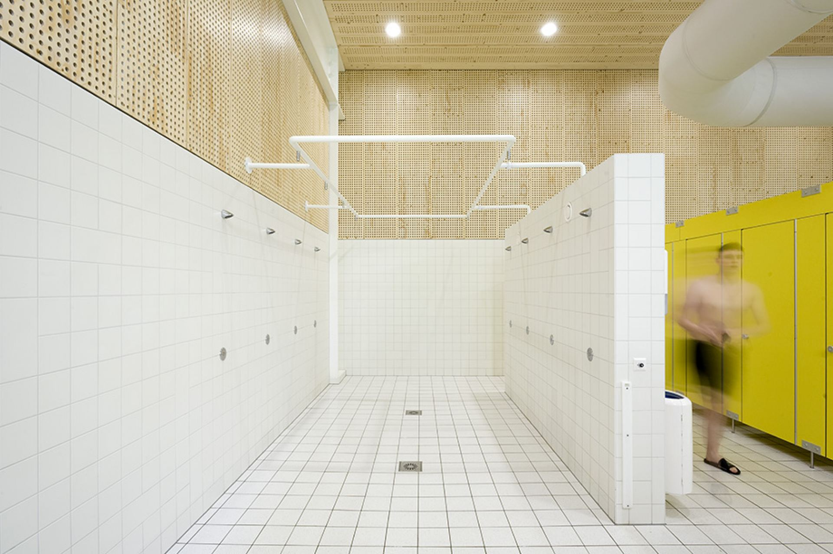
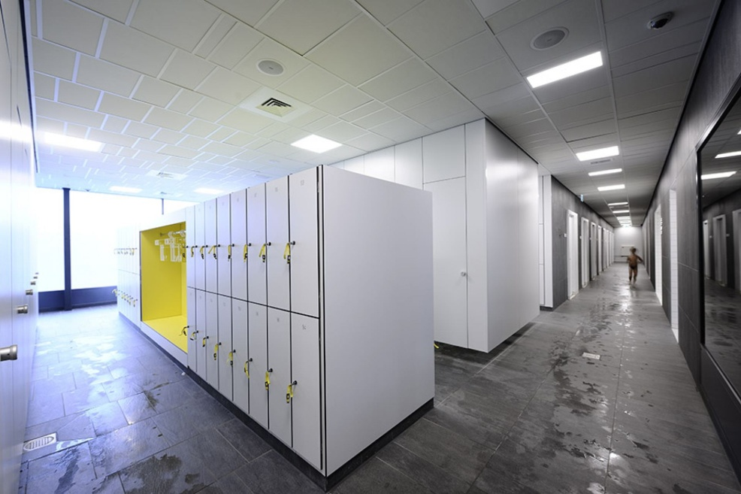
References
Shower and changing room

Slide 67
Project introduction
Project Requirements
Development Controls / Bylaws References
Site introduction
Conceptual Design
Sustainable Approach
Approach and methodology
Budgetary Estimate

Slide 68
Water Conservation
Rain Water Harvesting System
Surface water
Terrace water
Collection chamber
Recharge well
Collection chamber
Filtration plant
Ground water level
Under ground sump / Tank
Under ground sump / Tank
Over head tank
Over head tank
-Domestic use
-Drinking water
Domestic use
Central culvert to be used as collection at the time of monsoon – 2 Lac Liters capacity
Rain water methodology is adopted to store the water through percolation from paver blocks, seepage from open grounds and terraces of buildings.
It is then stored and can be used for irrigation of green areas throughout the year.

Slide 69
Water Conservation
Water Supply System
River water
Tube well water
Rain water harvested
Collection chamber
Collection chamber
Filtration plant
-Recharge well
-RCC culvert
Underground Sump/ Tank
Overhead tank
-Domestic use
-Drinking Water
Technical data
Raw water transfer pump
Pressure sand filter
Rota meter
Soft water plant

Slide 70


Solid Waste Management
Wastewater Management
Classification
Organic solid waste management –
Food scraps, yard (leaves, grass, brush) waste, wood, process residues
Earthworm farming (vermiculture) is a bio-technique for converting the solid into compost which can be used for soil conditioning. It prevents the production of methane gas thus making it environmentally sound waste management system and also a cost effective technique.
Inorganic solid waste management
Inorganic solid waste management –
Waste composed of material other than plant or animal matter for example glass, platic, metal, rubber etc. It is non or slowly bio degradable
The concept of three R is used –Reduce ,Reuse and Recycle
Sewage treatment plant
The process proposed is high efficiency Membrane Bio
Reactor (MBR) treatment scheme based on high
efficiency ultra filtration hollow fiber membranes.
The treated waste water shall be used for flushing, landscape irrigation and for make up water for the
cooling towers of the air conditioning system

Slide 71




Energy Conservation
Solar Energy:
Solar Lighting
The steel trusses are attached with solar panels that can generate electricity to make the building self sustainable.
The heat gained by steel member can be reduced accordingly.
Withstands wide range of climatic and shock environments
Return on investment unlike paying for utility bills
Solar street lights require much less maintenance compared to conventional street lights.
Solar panel street light is proposed as it is economical and environmentally beneficial.
Cricket stadium solar roof
Solar light poles
Parking shade roof
LED Lighting
Using a low-voltage power distribution system with LED lighting makes it more energy efficient, simpler and faster to install, and easier to control.
While lasting significantly longer than fluorescent products and up to 50 times longer than traditional incandescent lighting, LED lighting solutions offer tremendous energy and maintenance savings that easily justify their higher upfront cost. For this reason, LED lighting solutions are being widely adopted in retail, office, hospitality, roadway and outdoor lighting applications.

Slide 72


Other environmental friendly measures
Erosion and sedimentation control
Excavation should be done at Slope to retain earth sliding and soil erosion. Top soil should be preserved for further use for landscape.
Zero Discharge Building
All the waste water generated should be treated on site by Sewage treatment plant and the treated water shall be used for irrigation, flushing in toilets and AC makeup.
Night Pollution Reduction
All the exterior lighting provided should be down lighters with low LPD to prevent the glowing of sky.
Regional Materials
Building materials such as Concrete, AAC Blocks, glass, tiles, stone, MDF Boards, steel etc shall be sourced from a radius of 500 mile from site. Thus reducing the energy associated with the transportation of materials.

Slide 73




Construction Material
Autoclave Aerated Blocks:
AAC Block Advantages:
Light weight: safer during earthquakes
Fire resistant
Large size than bricks making it cost effective
Due to comparatively less thickness, it increase the usable space.
Better Finishing
Acoustically effective
Paver Block
The paver blocks used for the pathway area are heat resistant thus contributing to the Micro Climate. They also allow the water to penetrate thus keeping the ground cool.
Structure of Sports Complex
Indoor sports complex building PEB structure Proposed because typical pre-engineered steel building can be completed faster than conventional buildings and at a lower cost . Pre-engineered buildings score over conventional structures on Green Building considerations as well add aesthetic values also.

Slide 74
Project introduction
Project Requirements
Development Controls / Bylaws References
Site introduction
Conceptual Design
Sustainable Approach
Approach and methodology
Budgetary Estimate

Slide 75
CONSULTANT |  | CLIENT
1 | SITE SURVEYING & MEASUREMENTS
 | TAKING REAQUIREMENTS & CASE STUDIES | CLIENT REQUIREMENTS
 | CONCEPT DESIGNING & BUDGETARY ESTIMATE |  | MILESTIONE
 | TAKING APPROVALS | APPROVALS | SURVEYING INSTRUCTION
2 | DESIGN DEVELOPMENT |  | DESIGN PROCESS
 | DESIGN APPROVALS | APPROVALS | ESTIMATION TENDERING
 | PREPARING TENDER SRAWINGS |  | PROJECT EXECUTION
3 | SUBMITTING BILL OF QUANTITY WITH SPECIFICATION |  | HANDING OVER & TAKING OVER
 | SUBMITTING TENDER DOCUMENTS | INVITING TENDER
 | SUBMITTING WORKING DRAWINGS | RECEIVING PRICE BID
 | PREPARATION COMPARISION PRICE BID | OPENING TENDER
 |  | APPOINTING CONTRACTOR | CONTRACTOR
4 | ESTABLISHING PROJECT MANAGEMENT SYSTEM |  | PROJECT SCHEDULING
 | PERIODIC SITE VISIT & REVIEWING PROCESS | APPROVALS | MOCKUP/ PROTOTYPE
 | CHECKING QUALITY/ WORKMANSHIP
 | SUBMITTING PROGRESS REPORT
 | CHECKING & CERTIFYING RUNNING BILL |  | SUBMITTING RUNNING BILL
5 | PREPARING PUNCH POINT |  | CLEAR ALL PUNCH POINTS
 | FINAL MEASUREMENT CHECKING |  | FINAL MEASURING
 | AS BUILT DRAWING CHECKING/ SUBMITTING |  | SUBMIT AS BUILT DRAWING
 | CERTIFYING FINAL BILL MEASUREMENTS |  | FINAL BILL SUBMITTING
 |  | TAKING OVER ALL DOCUMENTS | HANDING OVER SITE
Adopted approach and methodology

Slide 76
Methodology and work plan
Adopted approach and methodology
Finalization of Plot Boundary - Pursuing absolute clarity about the location, area, and context of the plot to be used for project development.
Primary Site Investigation and Data Collection:
Topography of site
North direction
Areas with water logging potential on site
Load bearing capacity of soil
Velocity and direction of prevailing winds
Nearby sources for fresh water supply, municipal sewerage drains and storm water drains
Location of existing trees, any existing structures etc on site
Nala, river, or any structure of archeological importance in the vicinity of site

Slide 77
Methodology and work plan
Adopted approach and methodology
Project Conceptualization - Thorough review of development control regulations (DCR)
Maximum Permissible F.S.I. and Ground Coverage (If applicable).
Minimum Required margins and area of common plot.
Minimum width of approach road according the length of the road.
Minimum area of parking required.
Maximum permissible height of building.
Minimum Provisions to be made for differently disabled.
Minimum provision for power supply and backup power supply (Diesel Generator).
Minimum provision for water supply, sewerage, and rain water disposal/harvesting
Minimum specification and for landscape design
In which land use zone the site falls into.

Slide 78
Methodology and work plan
Adopted approach and methodology
Zoning and building arrangement in site showing the development in
phase manner. (1st phase and future expansion)
Approval form client on conceptual master plan – Presenting design drawings and
calculations to be to client for their comments. Modifications shall be made in conceptual
planning as per the client’s suggestions and final approval shall be obtained from the client.

Slide 79
Methodology and work plan
Adopted approach and methodology
Master plan for sports complex and conceptual drawings -Preparation of architectural
drawings shall immediately begin after the project conceptualization phase.
All floor plans, Elevations and sections for Indoor sports complex buildings
Detail layout of outdoor sports fields
Plan sections detail of swimming pool
Landscape layout and detail
Site plan (Covering information as mentioned below)
Site Area
No. of buildings
Building Height
Total Built-up Area
F.S.I. Consumed
Proposed Built-up area for Indoor sports complex buildings
Provided Parking area for users and visitors
Provided area for common plot

Slide 80

Methodology and work plan
Adopted approach and methodology
Organization Chart for the Staff Working on the Project - After modification and approval
from clients final architectural drawings shall be shared with allied agencies/teams
addressing other disciplines.
The bidder will work with the agencies representing different disciplines and organization
for work and communication will as provided under:
CLIENT

Slide 81
Methodology and work plan
Adopted approach and methodology
Structure Design - The job of agency will be to prepare structural design along with the
structural specification to withstand static/dynamic loads and seismic loads in accordance
with relevant IS Codes/ NBC.
Mechanical, Electrical, and Plumbing Design - The agency will be preparing the design and specification for the provisions of power supply, back-up supply, water-supply,
sewerage disposal, and storm water disposal as per relevant DCR/NBC regulations.
Information Exchange, Cross Disciplinary Communication, and Document Control Index:
Submission for Approval from Government Authorities: The bidder shall submit the
drawings to all the relevant government authorities mentioned in DCR as per their
requirement and obtain NOC as applicable.
Joint meeting shall be set for inter-disciplinary discussion on initial design
Conclusion of final design after necessary changes incorporated by agencies comments
Final design sharing with all agencies
Document control Index preparation and submission by agencies

Slide 82
Methodology and work plan
Adopted approach and methodology
Final Working Drawings: The bidder shall prepare and release detailed good for construction
drawings as per Master Document Control Index. A sample list of drawings to be provided is
as mentioned below:
Sr.No | Description
Architecture
1 | Design Basis Report
2 | Site Plan
 | Working drawings
3 | All Floor Plans
4 | Terrace Floor Plan
5 | Water Tank Machine Room Level Plan
6 | Elevations
7 | Sections
 | Details
8 | Indoor Sports hall detail
9 | Outdoor sports fields detail
10 | Swimming pool detail
11 | Door - Window Detail
12 | Flooring, Skirting / Dado and Kitchen Platform Detail
13 | Staircase Detail / Pedestrian Ramp / Railing Detail
14 | Typical Parapet/ Terrace Parapet / Water Proofing
15 | Toilet Detail
16 | Entry Gate & Compound Wall Detail
17 | Schedule of Finishes
 | External Development And Landscape
18 | Landscape Plan
19 | Paver, COP & Forestation Section Detail
Sr.No | Description
Plumbing
20 | Plumbing Design Basis Report
21 | Schematic Diagram For Water Supply
22 | Schematic Diagram For Sanitary Sewer System
23 | Schematic Diagram For Storm Water Drainage System
 | Building Drawings
24 | All Floor Water Supply Layout (including Enlarged Toilet details with sections)
25 | Terrace Water Supply Layout (including Sectional Details)
26 | All Floor Drainage Layout (including Enlarged Toilet details with sections)
27 | Terrace Drainage Layout (including Sectional Details)
 | Plumbing External Development
28 | External Water Supply Layout
29 | External Sanitary Sewer System Layout
30 | External Strom Water Network
31 | External Horticulture Water Supply Layout
32 | Details Of Catch Basin, Rain Water Trenches, Rain Water Harvesting Pit
33 | Details Of UG Tank (including sleeve details)
34 | Details Of OH Tank for cluster (including sleeve details)
35 | Details of Pump House
36 | Co-ordinated Services Layout (For PHE +FF Services)
37 | Misc Details Of PHE System (Gully Trap, Inspection Chamber, Manhole & Valve Pit, Rain Water Khurrah, etc.)
38 | Details Of Connection From Existing/ Municipal Sewer System
39 | Details Of Connection From Existing/ Municipal Water Supply System
40 | Details Of Connection From Existing/ Municipal Storm/ Rain water System

Slide 83
Methodology and work plan
Adopted approach and methodology
Sr.No | Description
Fire Fighting
41 | Design Basis Report
42 | Schematic Diagram For Fire Fighting System
 | Building Drawings
43 | All Floor Fire Fighting Layout (including locations of fire extinguishers, Nos, Type, etc)
44 | Terrace Floor Fire Fighting Layout (including locations of fire extinguishers, Nos, Type, etc)
45 | External Fire Fighting Layout (with backup calculations)
46 | Misc Details Of Fire Fighting System (such as Fire Hydrants, Fire Hose Cabinets, Hose Reel, Fire Brigade Connection, etc)
Electrical
47 | Design Basis Report
48 | Transformer Sizing Calculation
49 | DG Sizing Calculation
50 | Schematic Power Flow Diagram
51 | Schematic Telephone Riser Diagram
52 | Detail Layout For Electrical/Meter Room And Sleeve Details
 | Building Drawing
53 | Common Area All Floor Lighting And Power Control Layout
54 | Common Area Terrace & Machine Room Lighting And Power Layout
55 | Common Area All Floor Conduit Layout
56 | Common Area Typical Floor Conduit Layout
57 | Common Area Terrace & Machine Room Conduit Layout
58 | Electrical & ELV layout
 | Electrical External Development
59 | External Cable Route And Substation Location Layout
60 | External Lighting Layout
61 | Lightning Protection Layout
62 | Earthing Detail Drawings
63 | Typical Section Detail Drawing for DP Structure, Transformer Plinth, Earthing, Trench Section
64 | DG room & DG Section Detail Drawing plot wise.
65 | Meter/Electrical Room Section layout
66 | Section Detail Electrical/ELV Shaft
67 | Main Single Line diagram

Slide 84
Methodology and work plan
Adopted approach and methodology
Bill of Quantity and Estimate- Preparation of detail BOQ covering total construction cost of
all buildings and external development.
Periodical Site Visits during Construction: Periodical site visit and checking of to verify
ongoing construction with reference to already submitted IFC drawings and details. Site visit
reports submission to the client time to time.
Preparation and Submission of Completion Drawings: Preparation and submission of
completion drawings for the project as per the client’s requirement. The drawings shall represent the services as accurately as possible in order to make any
maintenance in future hassle free and convenient.

Slide 85
Adopted approach and methodology
Time Frame for the Milestones Defined for the Project / Work Plan:
Milestone | Activities | Weeks (in the form of a Bar Chart) |  |  |  |  |  |  |  |  |  |  |  |  |  |  |  |  |  |  |  | Number of Weeks
 |  | 1 | 2 | 3 | 4 | 5 | 6 | 7 | 8 | 9 | 10 | 11 | 12 | 13 | 14 | 15 | 16 | 17 | 18 | 19 | 20
1 | Key plan, concept plan and site layout |  |  |  |  |  |  |  |  |  |  |  |  |  |  |  |  |  |  |  |  | 2
2 | Final Master Plan, Presentation drawings and Cost estimates |  |  |  |  |  |  |  |  |  |  |  |  |  |  |  |  |  |  |  |  | 3
3 | Working drawings Plans, sections, elevations for building Unit, Excavation & Foundation Drawings, and all structural drawings. |  |  |  |  |  |  |  |  |  |  |  |  |  |  |  |  |  |  |  |  | 4
4 | Working drawings for utilities and services |  |  |  |  |  |  |  |  |  |  |  |  |  |  |  |  |  |  |  |  | 4
5 | Landscape drawings and utilities |  |  |  |  |  |  |  |  |  |  |  |  |  |  |  |  |  |  |  |  | 2
6 | Draft tender drawing and document & Tender Process |  |  |  |  |  |  |  |  |  |  |  |  |  |  |  |  |  |  |  |  | 2
7 | Submission drawings to local authorities |  |  |  |  |  |  |  |  |  |  |  |  |  |  |  |  |  |  |  |  | 3
9 | Periodic Site visit to ensure Construction as per drawings | Till constrction is on-going
10 | Preparation and submission of completion drawings | Three weeks after Completion

Slide 86
Project Introduction
Project Requirements
Development Controls / Bylaws References
Site introduction
Conceptual Design
Sustainable Approach
Approach and methodology
Budgetary Estimate

Slide 87
 |  |  |  |  | 19-Aug-19
Subject : Budgetary Estimate For Development and construction of Sports Facilities (Complex) in the Campus of Gujarat National Law University, Gandhinagar
No | Description | Option 1 |  | Description | Option 2
 | PHASE - I |  |  | PHASE - I
1A | Indoor Sports Complex |  |  | Indoor Sports Complex
 | Civil ( Lower Ground + Upper Ground + First floor) | 9 02 87 500.00 |  | Civil (Lower Ground + Upper Ground + First floor) | 9 02 87 500.00
 | Electrical ( Lower Ground + Upper Ground + First floor) | 2 74 47 400.00 |  | Electrical (Upper Ground + First floor) | 1 63 70 400.00
 | Interior Furniture ( Lower Ground + Upper Ground + First floor) | 1 34 75 000.00 |  | Interior Furniture (Upper Ground + First floor) | 88 00 000.00
 | HVAC ( Air conditioning) ( Lower Ground + Upper Ground + First floor) | 2 16 00 000.00 |  | HVAC ( Air conditioning) (Upper Ground + First floor) | 1 29 60 000.00
 | Fabric / ACP canopy | 15 00 000.00 |  | Fabric / ACP canopy | 15 00 000.00
 |  |  |  | Residential Zone
 |  |  |  | Civil (Second floor to Seventh floor) | 4 18 50 000.00
 | Total Amount of Phase I | 15 43 09 900.00 |  | Total Amount of Phase I | 17 17 67 900.00
 | PHASE II |  |  | PHASE II
 |  |  |  | Indoor Sports Complex (Lower Ground )
 |  |  |  | Electrical | 1 10 77 000.00
 |  |  |  | Interior Furniture | 46 75 000.00
 |  |  |  | HVAC ( Air conditioning) | 86 40 000.00
1B | Residential Zone (Second floor to Seventh floor) |  |  | Residential Zone (Second floor to Seventh floor)
 | Civil | 4 18 50 000.00
 | Electrical | 70 24 773.60 |  | Electrical | 70 24 773.60
 | Interior Furniture | 2 04 00 000.00 |  | Interior Furniture | 2 04 00 000.00
 | HVAC ( Air conditioning) | 50 75 000.00 |  | HVAC ( Air conditioning) | 50 75 000.00
1 C | External Development | 2 40 00 000.00 |  | External Development | 2 40 00 000.00
 | Total Amount of Phase II | 9 83 49 773.60 |  | Total Amount of Phase II | 8 08 91 773.60
 | Total Amount of PHASE - I + PHASE II | 25 26 59 673.60 |  | Total Amount of PHASE - I + PHASE II | 25 26 59 673.60
 | GST 18% | 4 54 78 741.25 |  |  | 4 54 78 741.25
 | Total Amount with GST | 29 81 38 414.85 |  |  | 29 81 38 414.85
Note: This is only budgetary estimate, the total amount may vary as per detail drawings and specifications.

Slide 88
Subject : Budgetary Estimate For Development and construction of Sports Facilities (Complex) in the Campus of Gujarat National Law University, Gandhinagar
Option 1
Sr. No | Description | Qty | Unit | Rate | Amount
 | PHASE - I
A | Indoor Sports Complex ( Lower Ground + Upper Ground + First floor)
1 | Construction of Multipurpose sports hall including games like, badminton, basket ball, volleyball, handball, netball and table tennis ,as boxing ring, judo, weight lifting, gym, yoga , Audio-Video Hall, Lecture Hall , Viewing Galley , Health Center/Dispensary, Sports Physiotherapy Center, Students Recreation Canteen/ cafeteria with common amenities . | 7223.00 | Sq.mt | 12500.00 | 9 02 87 500.00
2 | Electrical work with light fittings ,cabling, Electrical low wattage work with smoke detector, general PA system,Security & surveillance system like CCTV cabling work,acess control cabling work, fire fighting work with sprinker, data networking etc complete. etc | 7223.00 | Sq.mt | 3800.00 | 2 74 47 400.00
3 | Interior furnishing work like false ceiling, Inteior furniture with Veneer & laminate finish with polishing, partition, Diff. type of flooring, glass partition, glass door , glass film , sofa , chair,blinds , Paint , Artifects, planters etc complete. | 2450.00 | Sq.mt | 5500.00 | 1 34 75 000.00
4 | HVAC ( Air conditioning work ) for Double height area , Canteen , Lecture hall , Office , Yoga hall ,Wrestling , Judo , Gym , AV hall | 400.00 | TR | 54000.00 | 2 16 00 000.00
5 | Fabric / ACP canopy with necessary fittings etc. completed | 300.00 | Sq.mt | 5000.00 | 15 00 000.00
 | Total Amount |  |  |  | 15 43 09 900
 | PHASE - II
1 | Construction of Guest house building | 3348.00 | Sq.mt | 12500.00 | 4 18 50 000.00
2 | Electrical work with light fittings ,cabling, Electrical low wattage work with smoke detector, general PA system,Security & surveillance system like CCTV cabling work,acess control cabling work, fire fighting work with sprinker, data networking etc complete. | 3348.00 | Sq.mt | 2098.20 | 70 24 773.60
3 | Interior furniture for Guest House Building | 2400.00 | Sq.mt | 8500.00 | 2 04 00 000.00
4 | HVAC ( Air conditioning work ) for Room area | 145.00 | TR | 35000.00 | 50 75 000.00
 | Total Amount |  |  |  | 7 43 49 774
 | Total Amount for Phase I + Phase II |  |  |  | 22 86 59 674
 | GST 18% |  |  |  | 4 11 58 741.25
 | Total amount with GST |  |  |  | 57 28 27 862.05
 | Exclusion item
 | Any type of Euipment , Projector , screen
 | Any type of sports Equipment

Slide 89
Subject : Budgetary Estimate For Development and construction of Sports Facilities (Complex) in the Campus of Gujarat National Law University, Gandhinagar
Option 2
Sr. No | Description | Qty | Unit | Rate | Amount
 | PHASE - I
A | Indoor Sports Complex
1 | Construction of Multipurpose sports hall including games like, badminton, basket ball, volleyball, handball, netball and table tennis ,as boxing ring, judo, weight lifting, gym, yoga , Audio-Video Hall, Lecture Hall , Viewing Galley , Health Center/Dispensary, Sports Physiotherapy Center, Students Recreation Canteen/ cafeteria with common amenities. ( Lower Ground + Upper Ground + First floor) | 7223.00 | Sq.mt | 12500.00 | 9 02 87 500.00
2 | Electrical work with light fittings ,cabling, Electrical low wattage work with smoke detector, general PA system,Security & surveillance system like CCTV cabling work,acess control cabling work, fire fighting work with sprinker, data networking etc complete. etc ( Upper Ground + First floor) | 4308.00 | Sq.mt | 3800.00 | 1 63 70 400.00
3 | Interior furnishing work like false ceiling, Inteior furniture with Veneer & laminate finish with polishing, partition, Diff. type of flooring, glass partition, glass door , glass film , sofa , chair,blinds , Paint , Artifects, planters etc complete. ( Upper Ground + First floor) | 1600.00 | Sq.mt | 5500.00 | 88 00 000.00
4 | HVAC ( Air conditioning work ) for Double height area , Canteen , Lecture hall , Office , Yoga hall ,Wrestling , Judo , Gym , AV hall .( Upper Ground + First floor) | 240.00 | TR | 54000.00 | 1 29 60 000.00
5 | Fabric / ACP canopy with necessary fittings etc. completed | 300.00 | Sq.mt | 5000.00 | 15 00 000.00
B | Residential Zone (Second floor to seventh Floor)
1 | Construction of Guest house building | 3348.00 | Sq.mt | 12500.00 | 4 18 50 000.00
 | Total Amount |  |  |  | 17 17 67 900
 | PHASE - II
1 | Electrical work with light fittings ,cabling, Electrical low wattage work with smoke detector, general PA system,Security & surveillance system like CCTV cabling work,acess control cabling work, fire fighting work with sprinker, data networking etc complete. etc ( Lower Ground ) | 2915.00 | Sq.mt | 3800.00 | 1 10 77 000.00
2 | Interior furnishing work like false ceiling, Inteior furniture with Veneer & laminate finish with polishing, partition, Diff. type of flooring, glass partition, glass door , glass film , sofa , chair,blinds , Paint , Artifects, planters etc complete. ( Lower Ground) | 850.00 | Sq.mt | 5500.00 | 46 75 000.00
3 | HVAC ( Air conditioning work ) for Double height area , Canteen , Lecture hall , Office , Yoga hall ,Wrestling , Judo , Gym , AV hall .( Lower Ground) | 160.00 | TR | 54000.00 | 86 40 000.00
B | Residential Zone ( Second floor to seventh Floor)
1 | Electrical work with light fittings ,cabling, Electrical low wattage work with smoke detector, general PA system,Security & surveillance system like CCTV cabling work,acess control cabling work, fire fighting work with sprinker, data networking etc complete. | 3348.00 | Sq.mt | 2098.20 | 70 24 773.60
2 | Interior furniture for Guest House Building | 2400.00 | Sq.mt | 8500.00 | 2 04 00 000.00
3 | HVAC ( Air conditioning work ) for Room area | 145.00 | TR | 35000.00 | 50 75 000.00
 | Total Amount |  |  |  | 5 68 91 774
 | TOTAL AMOUNT FOR PHASE - I + PHASE II |  |  |  | 22 86 59 674
 | GST 18% |  |  |  | 1 02 40 519.25
 | Total amount with GST |  |  |  | 29 57 91 966.45
Note: This is only budgetary estimate, the total amount may vary as per detail drawings and specifications.

Slide 90
Thank you

